Slide 1

Equipping professionals with dementia care tools
Long Term Care Community Coalition
nursinghome411.org

Slide 2
The Long Term Care Community Coalition
LTCCC: Nonprofit, nonpartisan organization dedicated to improving care & quality of life for the elderly & adult disabled in long-term care (LTC).
Our focus: People who live in nursing homes & assisted living.
What we do:
  Policy analysis and systems advocacy;
  Data resources & analyses;
  Education of consumers and families, LTC ombudsmen, and other stakeholders;
  Home of two local LTC Ombudsman Programs in the Hudson Valley, New York
Website: www.nursinghome411.org
  Range of free resources on nursing home and assisted living care

Slide 3
Training Goals
Introduce the Dementia Care in the Community Toolkit
Prepare professionals to share tools with families and caregivers
Support person-centered dementia care practices
Provide practical strategies for education and outreach

Slide 4
Why This Matters
Professionals are often the first points of contact for overwhelmed families
Families face behavior changes, safety concerns, and caregiver burnout
Many caregivers struggle to find trustworthy, practical information
Professionals benefit from ready-to-use educational tools

Slide 5
Introducing the LTCCC Toolkit
Free, online resource available at NursingHome411.org
Available in English and Spanish
Designed for both family and professional caregivers
Supports people living at home or in assisted living

Slide 6
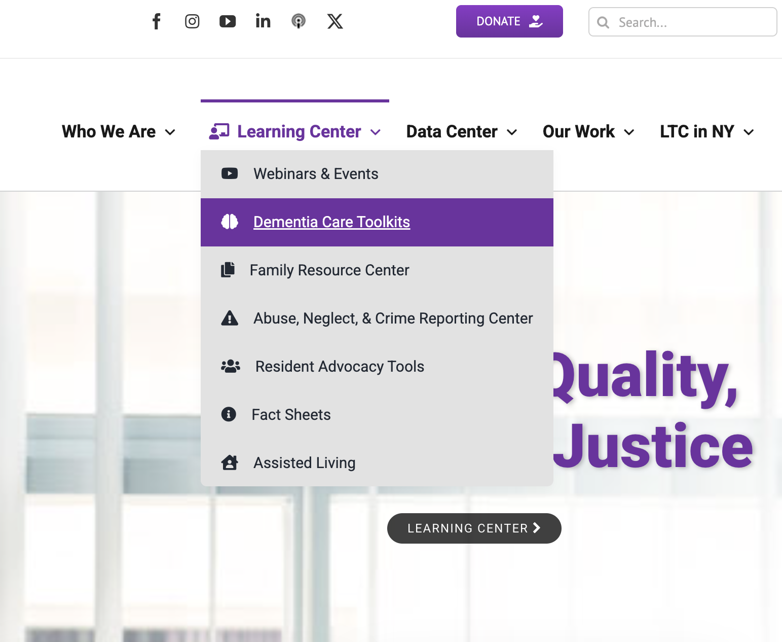
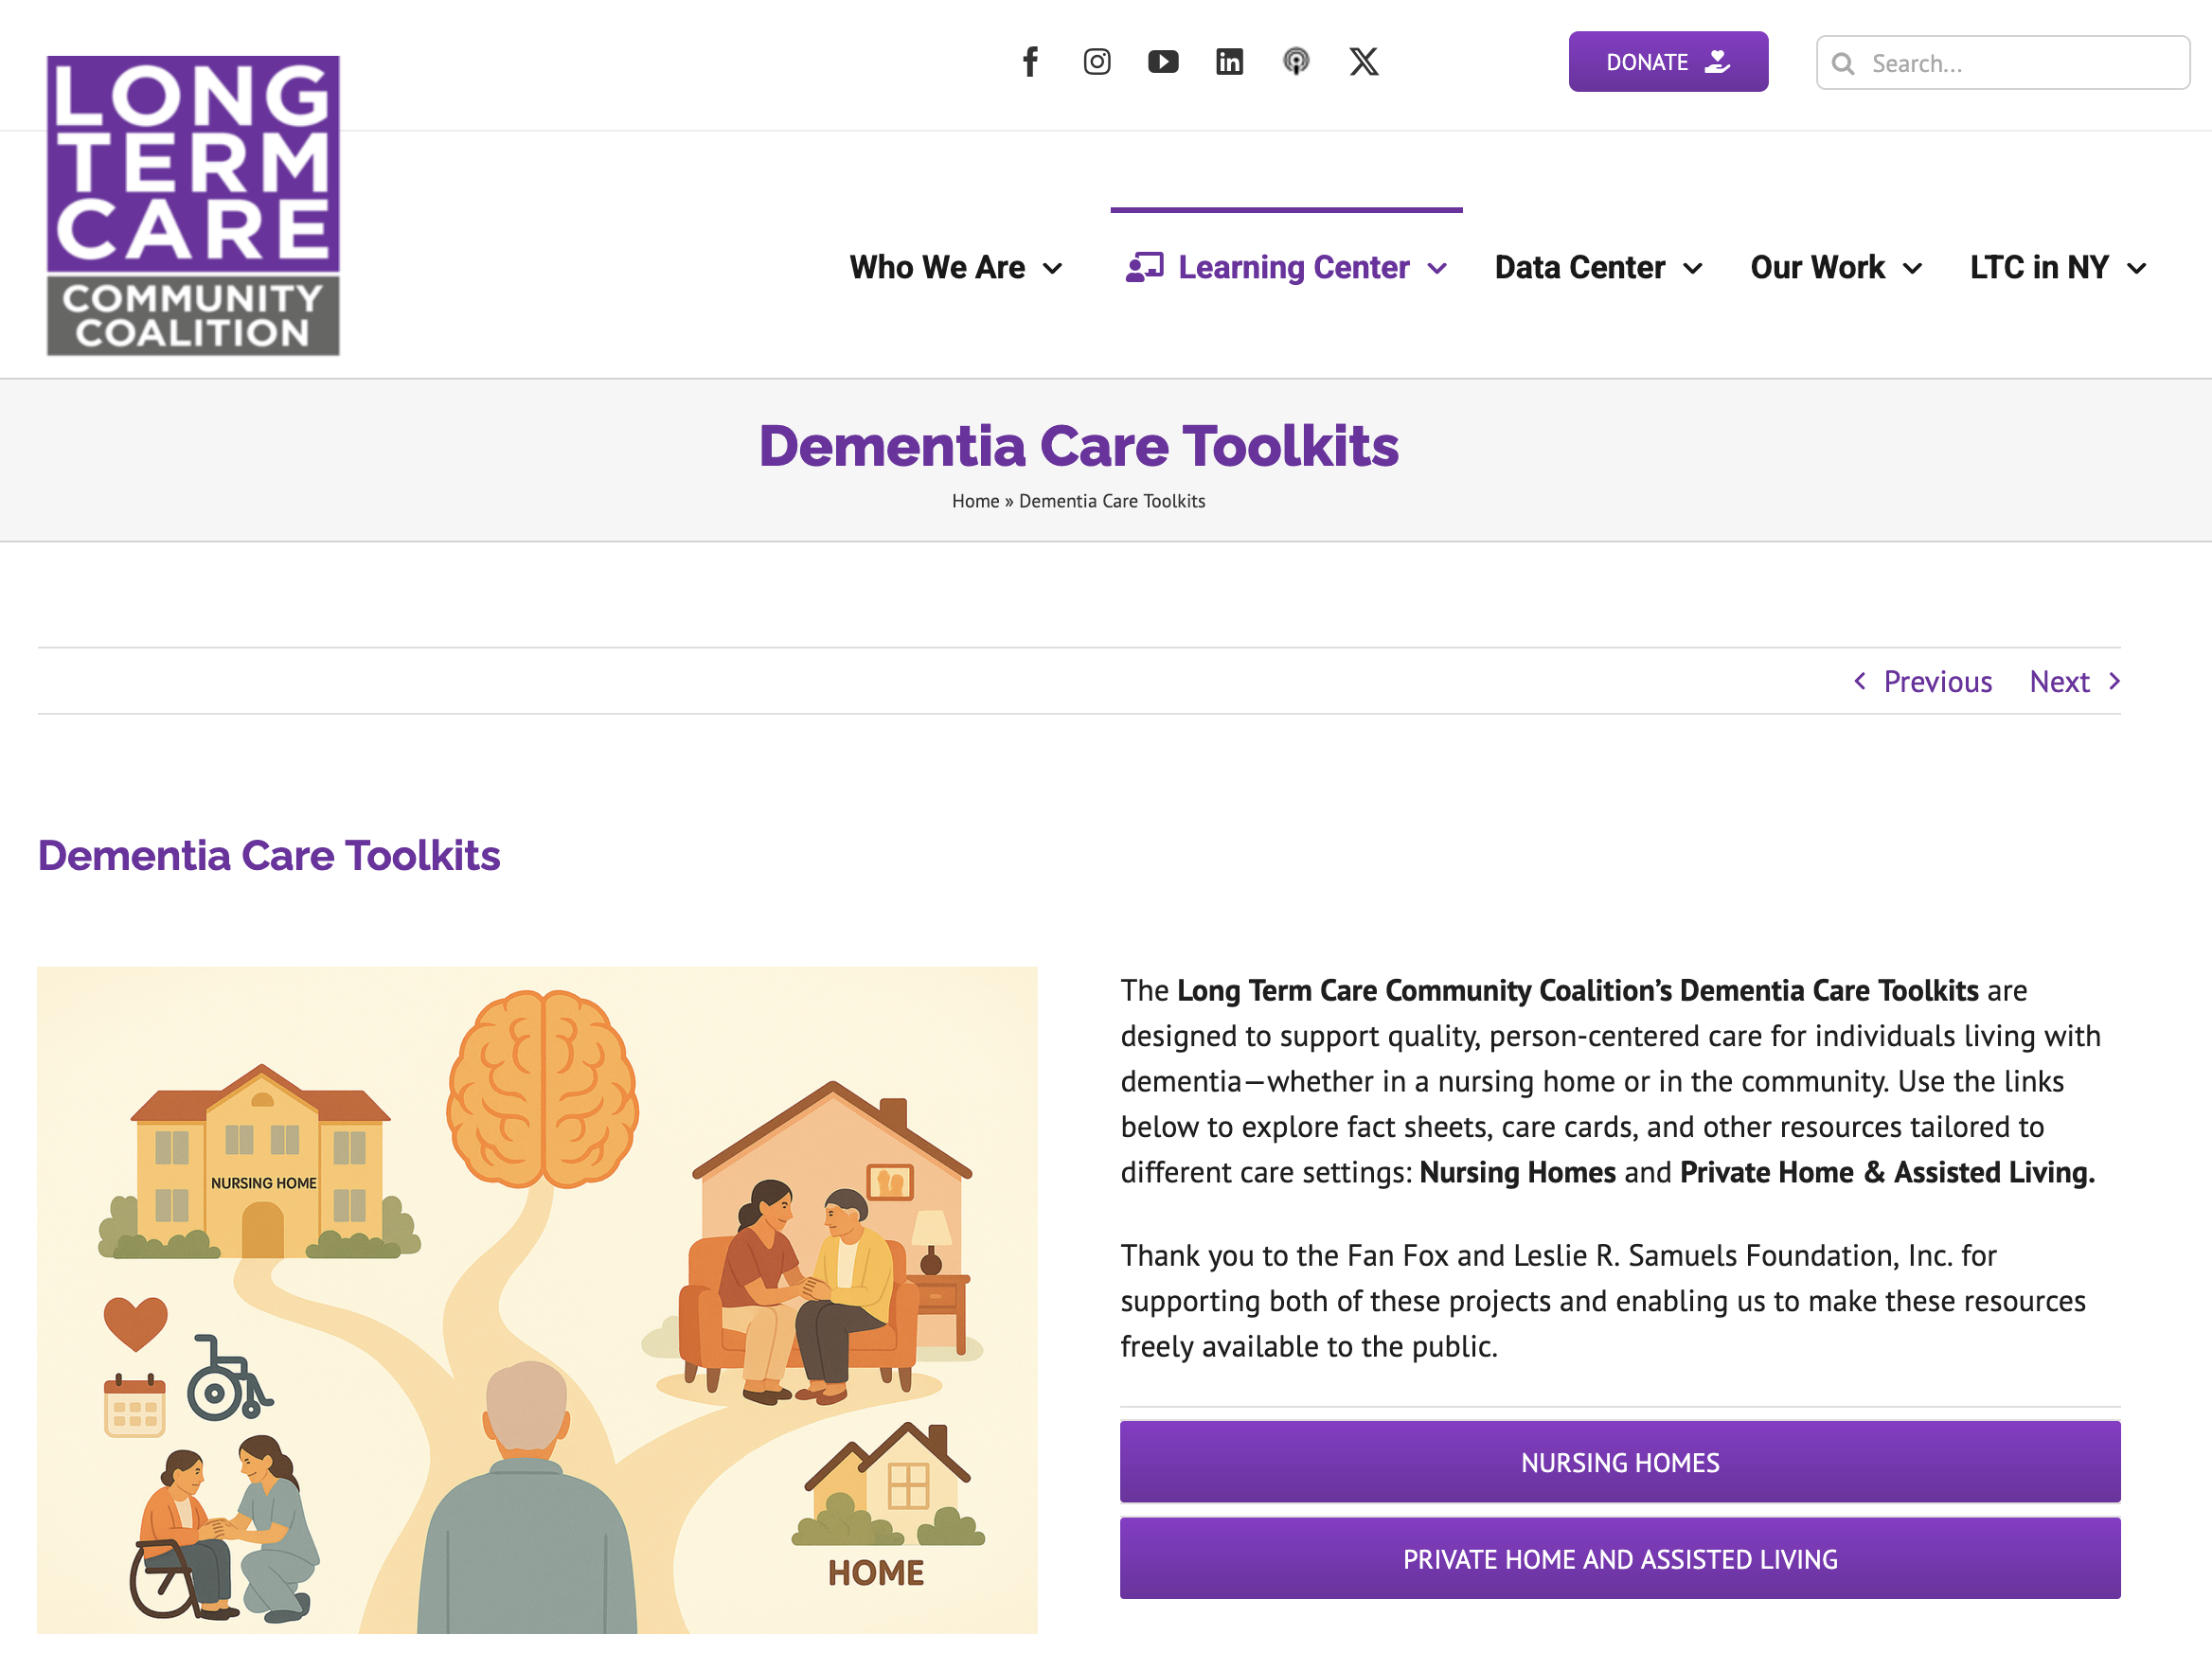
Accessing the Toolkit
Visit nursinghome411.org
Accessible via phone, tablet, or computer
No login or subscription required
Easy to share

Slide 7
What’s Inside the Toolkit
Fact Sheets: provide deeper but user-friendly information on dementia topics
Care Cards: quick, practical tips for real-time situations
Mini-Modules: short videos for learning and group discussion
External resources for deeper learning

Slide 8
Fact Sheets: What They Provide
Clear, plain-language guidance on dementia and caregiving
Designed for family members and caregivers
Topics include:
  Care planning
  Home Safety
  Pain Assessment Tools
  Preventing Pressure Ulcers and Urinary Tract Infections
  Understanding and Responding to Dementia-Related “Behaviors”
  Palliative and Hospice Care: What Families Need to Know
  Psychotropic Drugs: Risks, Benefits, and Questions to Ask

Slide 9
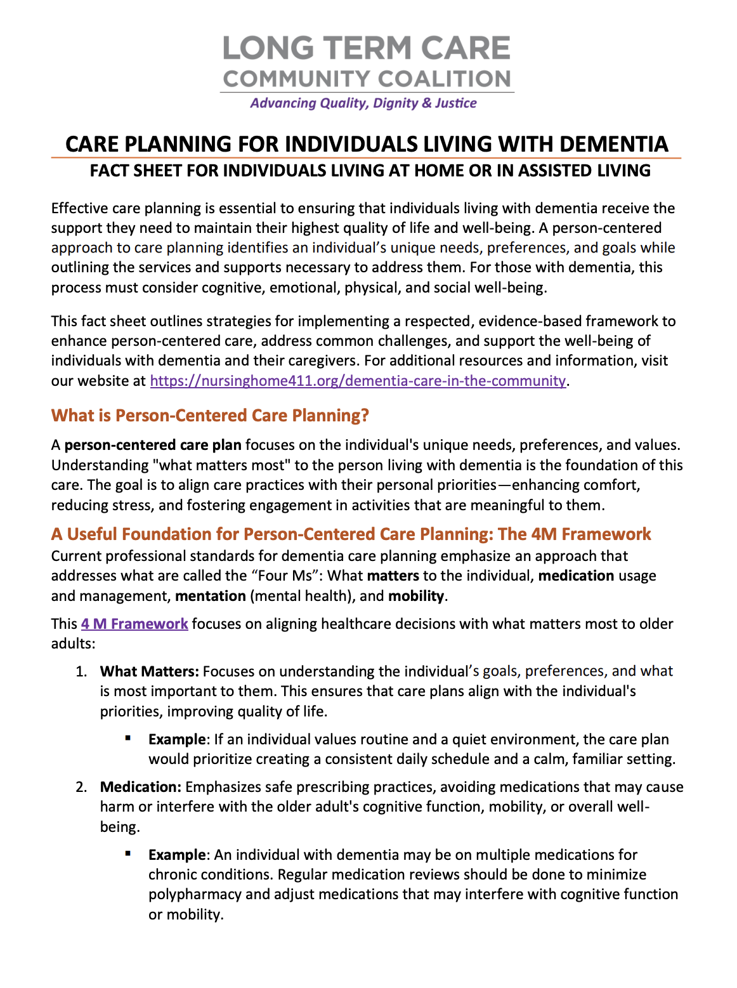
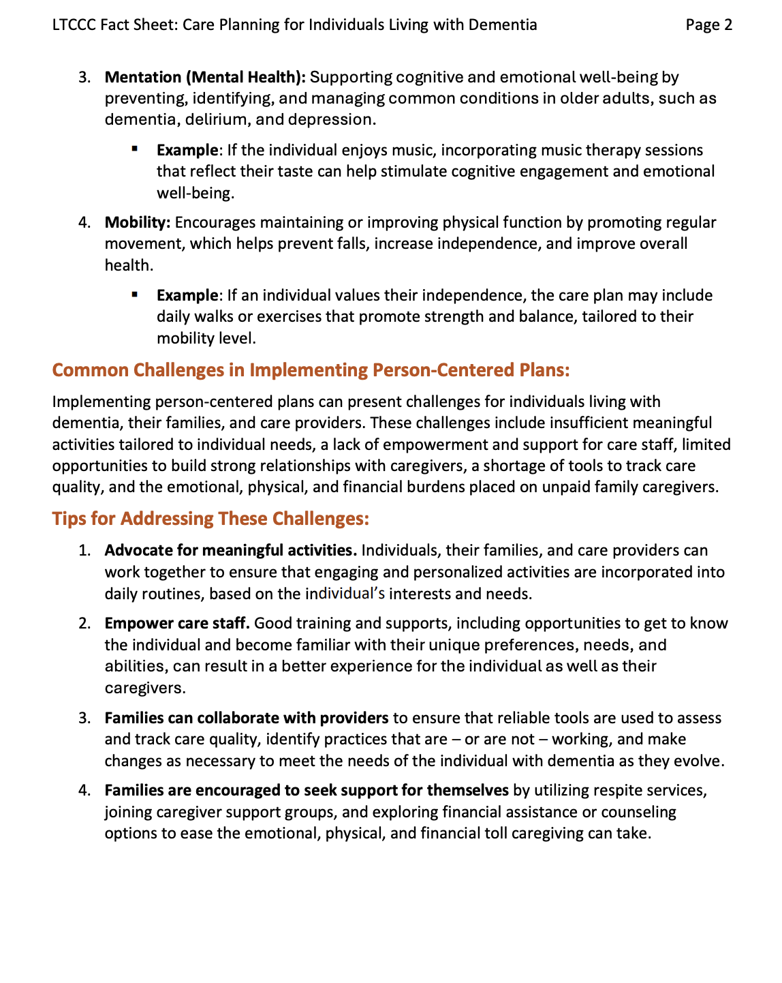

Slide 10
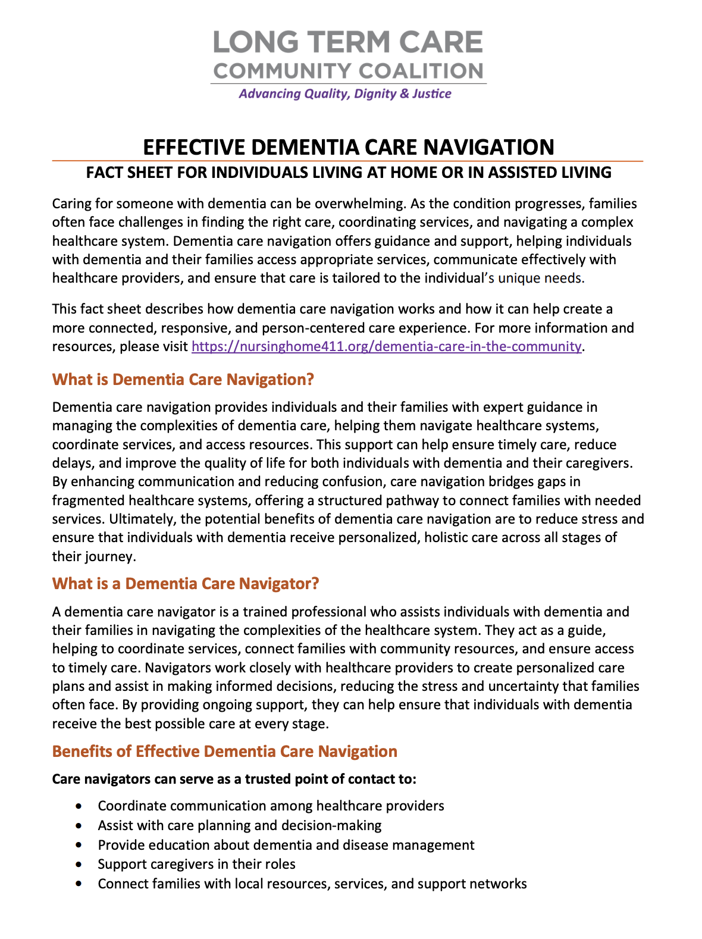
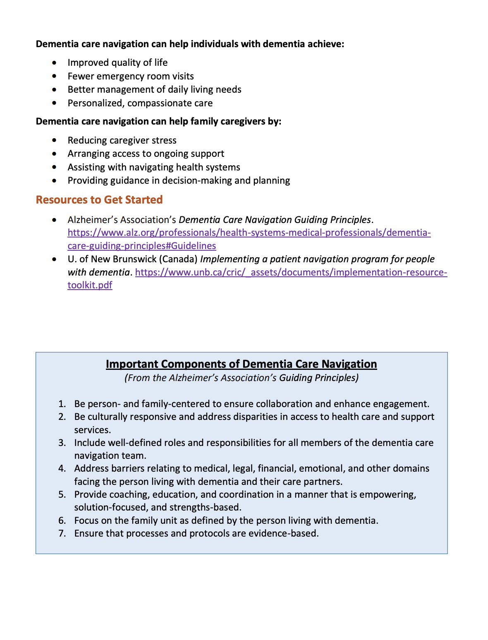

Slide 11
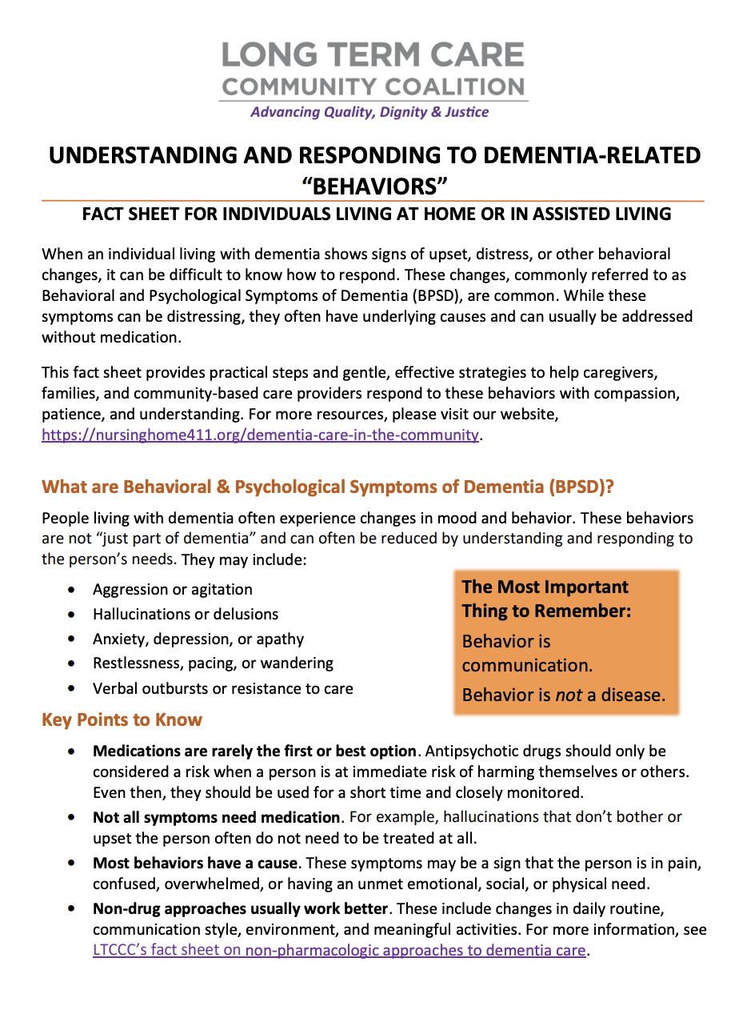
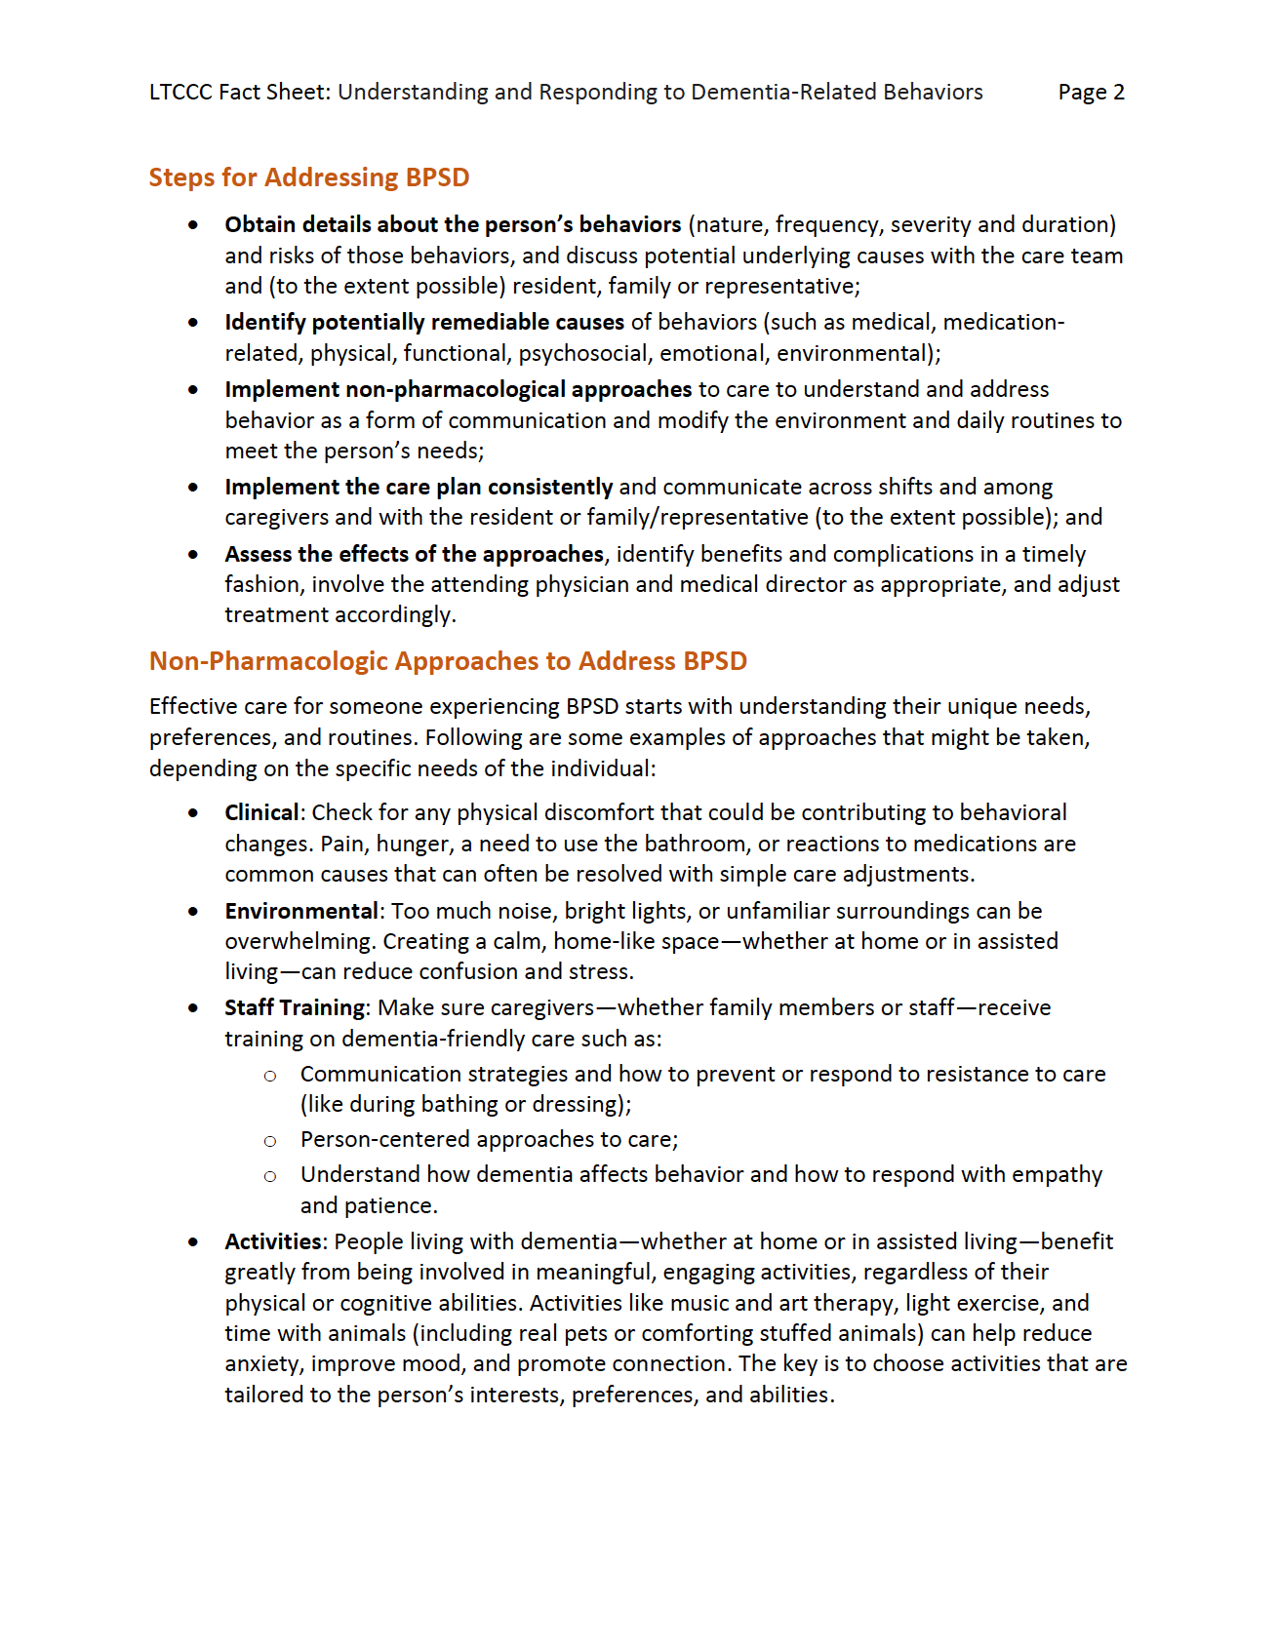

Slide 12
How Professionals Can Use Fact Sheets
Provide families with trusted guidance during emotionally challenging situations
Support conversations about behavior changes, safety concerns, and care planning
Help families better understand dementia-related symptoms and communication changes
Reinforce recommendations around home care, assisted living, and next steps

Slide 13
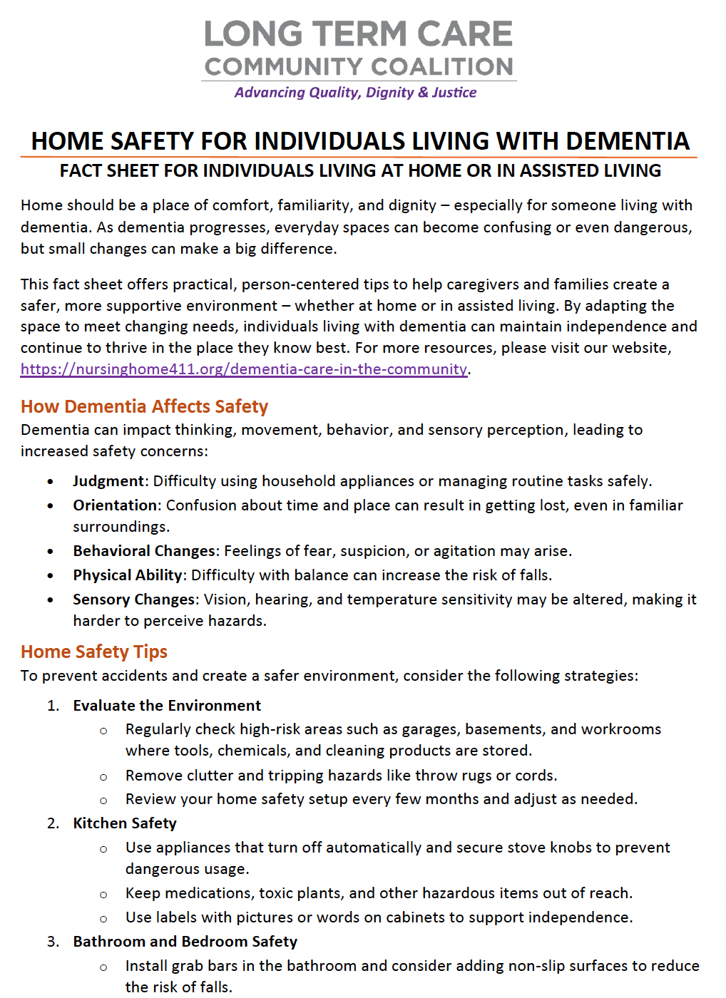
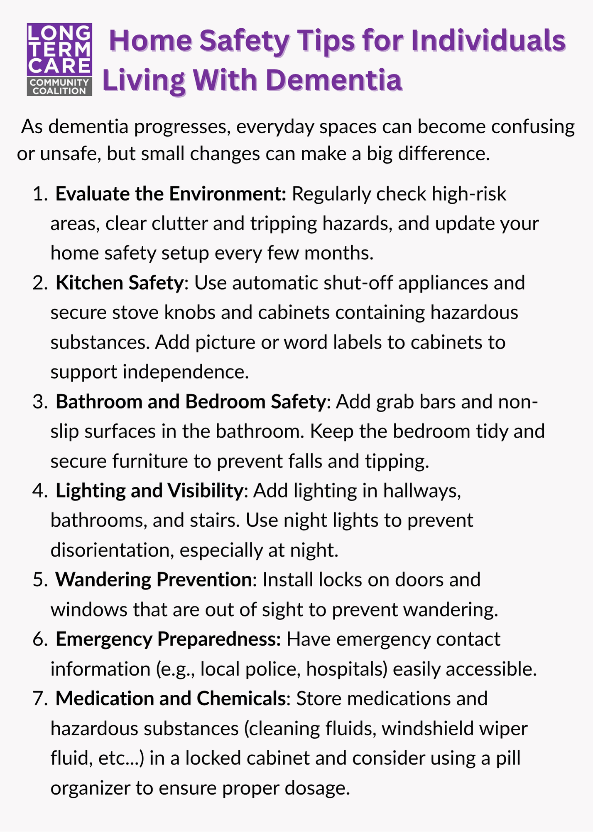
Care Cards: What They Provide
Quick, easy-to-read tips for everyday caregiving situations
Designed for real-life moments when immediate guidance is needed
Mobile-friendly – can be saved or accessed on a phone
Focus on simple, actionable strategies

Slide 14
How Professionals Can Use Care Cards
Share quick, practical strategies families can use during moments of stress or crisis
Support caregivers managing agitation, confusion, wandering, or communication difficulties
Offer easy-to-access tools families can reference at home or on mobile devices
Use during consultations, support groups, or caregiver coaching sessions

Slide 15
Mini-Modules: What They Provide
Short, focused educational videos
Designed for busy caregivers with limited time
Cover key caregiving topics in a simple, approachable way
Can be watched individually or shared in group settings

Slide 16
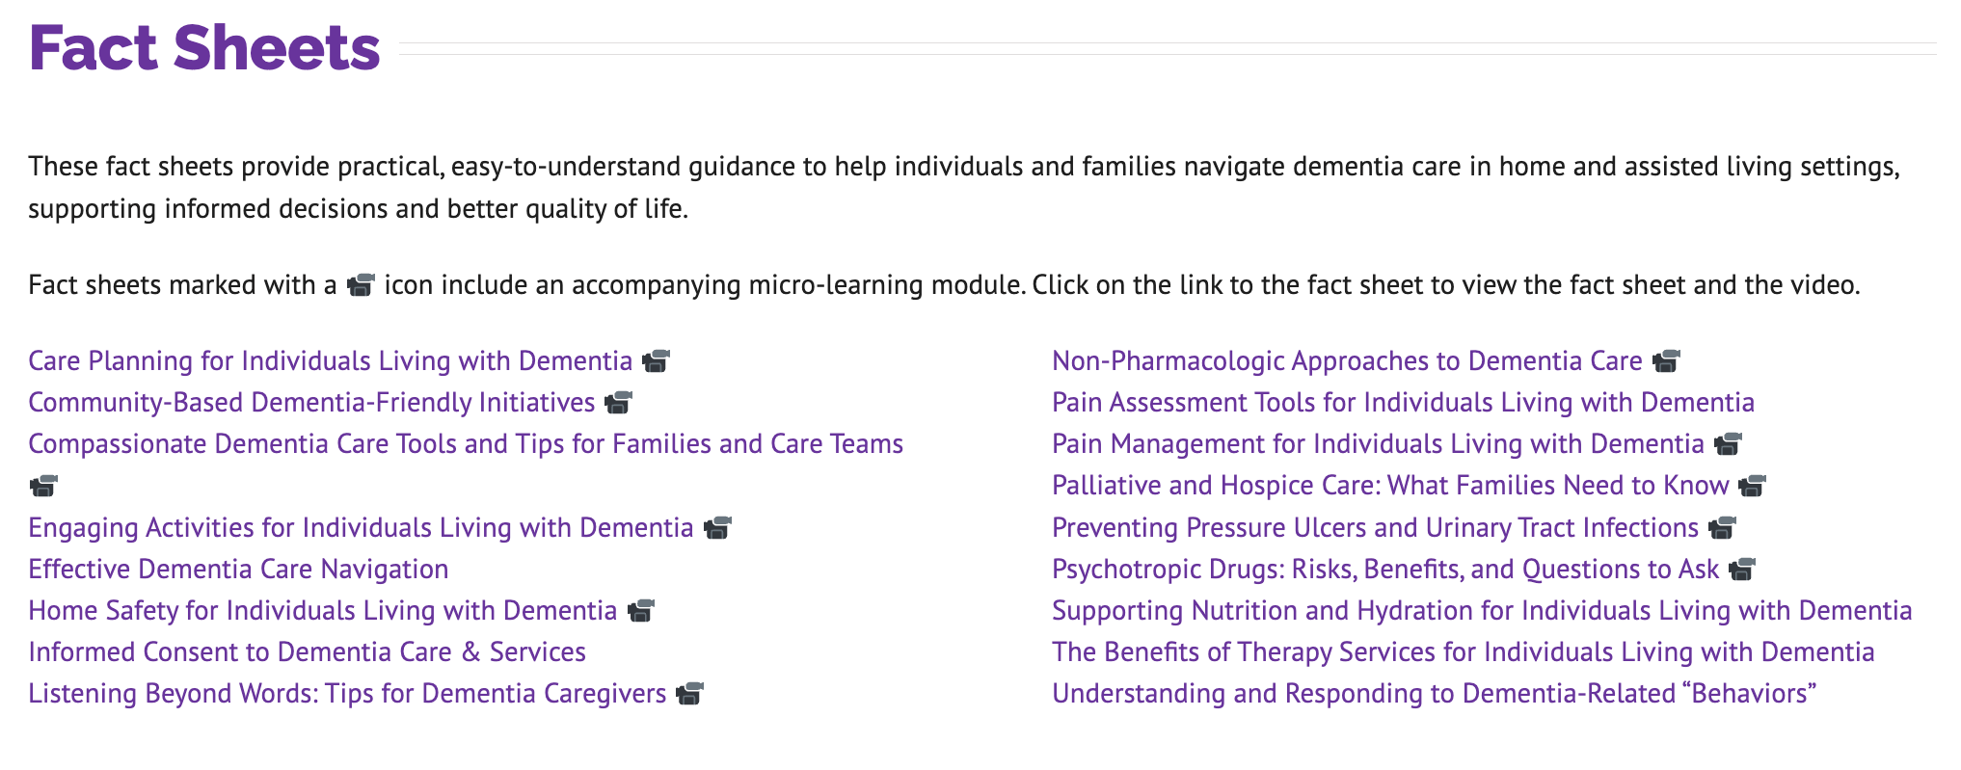

Slide 17
How Professionals Can Use Mini-Modules
Use brief videos to introduce key dementia care concepts to families and caregivers
Support staff education and reinforce person-centered care practices
Provide flexible learning tools during support groups, trainings, or outreach efforts
Encourage discussion around challenging caregiving situations and available supports

Slide 18
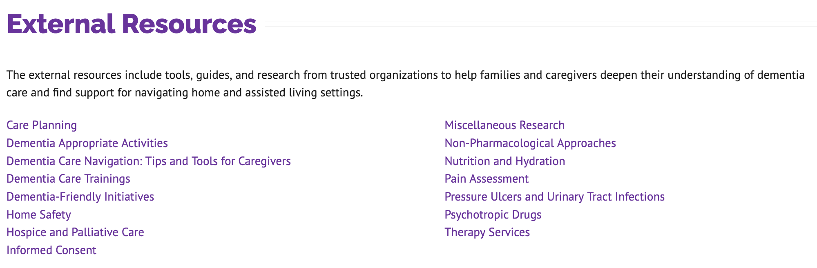
External Resource Library
All of the fact sheets and care cards are based on professional standards and expert research. The Toolkit page provides a curated list of these external resources for those looking to dig deeper.

Slide 19
How Professionals Can Use the Toolkit
Share links or PDFs with families after consultations
Use care cards during support groups or education sessions
Reinforce recommendations already provided to families
Support new staff, volunteers, and community partners

Slide 20
Sample Training Agenda
(can be done in-person, via video conference, or hybrid)
Welcome and introductions
Overview of dementia caregiving realities
Walkthrough of toolkit resources
Show a mini-module video
Discussion and implementation ideas

Slide 21
Conversation Starters
“What caregiving challenges do families ask about most often?”
“What dementia-related situations are hardest for families to manage?”
“How can we better support caregivers in the community?”
“What resources would be most helpful to share?”

Slide 22
Implementation Ideas
Incorporate materials into staff orientation
Use during caregiver support groups
Share through newsletters or resource guides
Highlight one care card or fact sheet each month
Integrate into wellness and community outreach programs

Slide 23
Key Messages for Trainers
Caregiving challenges are common and often overwhelming
Behavior is communication
Practical education can reduce stress and crises
Professionals do not need all the answers – resources matter
Empathy and person-centered care is essential

Slide 24
Next Steps
Explore the toolkit
  Nursinghome411.org/dementia-care-in-the-community
Identify opportunities to share resources in your organization
Use the toolkit to support caregivers and staff
Check out other resources available at www.nursinghome411.org

Slide 25
Thank you!
Questions?
Comments?
nursinghome411.org

