Slide 1

SUPPORTING CONSTITUENTS LIVING WITH DEMENTIA
Long Term Care Community Coalition
nursinghome411.org

Slide 2
The Long Term Care Community Coalition
LTCCC: Nonprofit, nonpartisan organization dedicated to improving care & quality of life for the elderly & adult disabled in long-term care (LTC).
Our focus: People who live in nursing homes & assisted living.
What we do:
Policy analysis and systems advocacy;
Data resources & analyses;
Education of consumers and families, LTC ombudsmen, and other stakeholders;
Home of two local LTC Ombudsman Programs in the Hudson Valley, New York
Website: www.nursinghome411.org
Range of free resources on nursing home and assisted living care

Slide 3
Training Goals
Introduce the Dementia Care in the Community Toolkit
Provide practical ways to connect families with trustworthy information and support
Prepare staff and interns to recognize common dementia caregiving challenges
Support community outreach and constituent service efforts

Slide 4
Why This Matters
Many constituents are balancing work, caregiving, and financial stress while supporting a loved one living with dementia
District offices frequently receive calls about home care, assisted living, nursing homes, and caregiver crises
Families often need help understanding next steps, available services, and care options
Legislative offices can play an important role by connecting families to trusted resources

Slide 5
Introducing the LTCCC Toolkit
Free, online resource available at NursingHome411.org
Available in English and Spanish
Designed for both family and professional caregivers
Supports people living at home or in assisted living

Slide 6
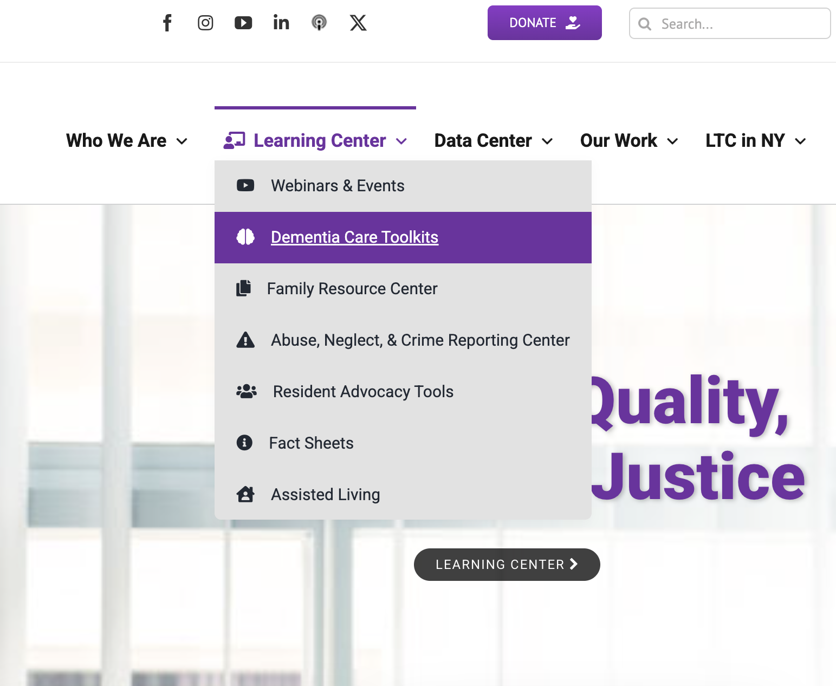
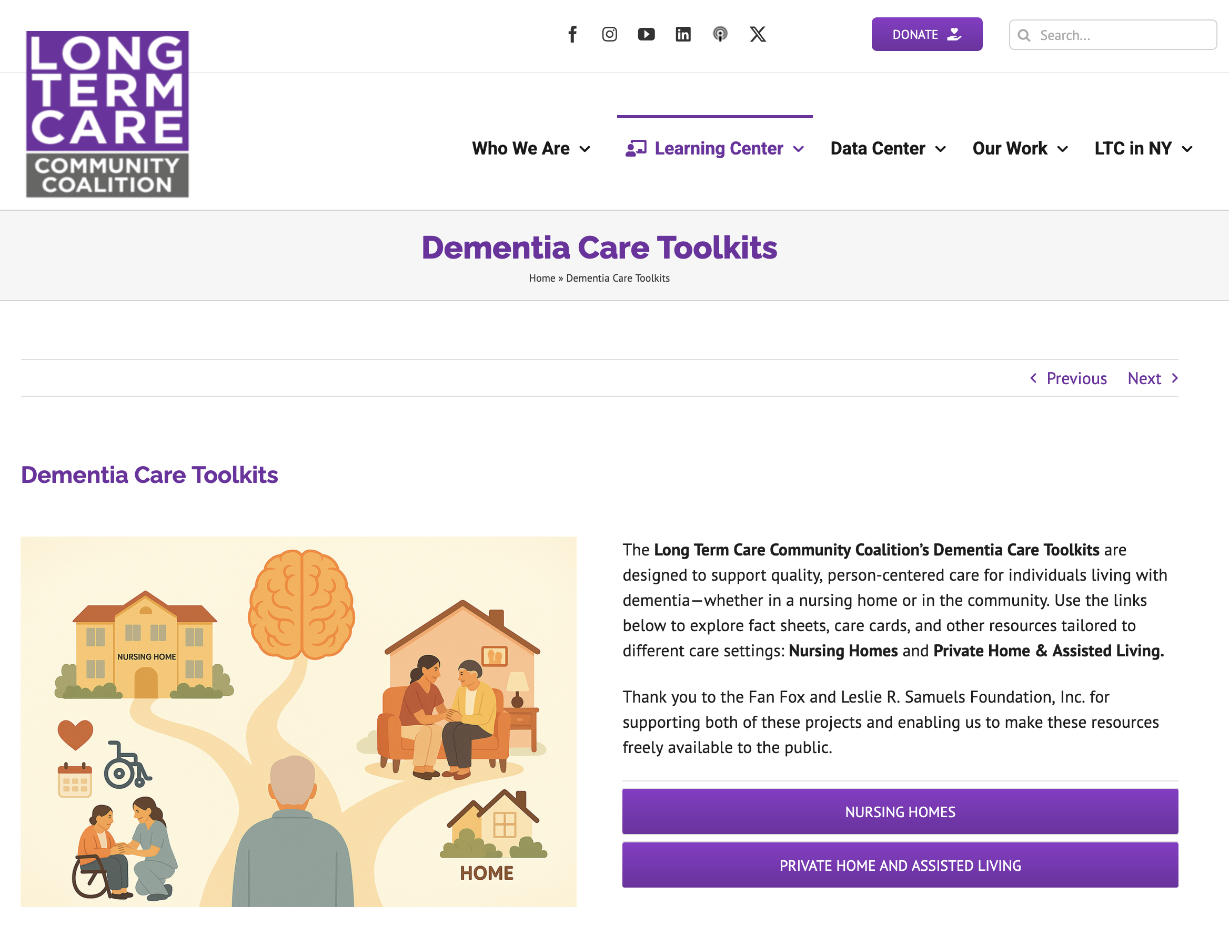
Accessing the Toolkit
Visit nursinghome411.org
Accessible via phone, tablet, or computer
No login or subscription required
Easy to share

Slide 7
What’s Inside the Toolkit
Fact Sheets: provide deeper but user-friendly information on dementia topics
Care Cards: quick, practical tips for real-time situations
Mini-Modules: short videos for learning and group discussion
External resources for deeper learning

Slide 8
Fact Sheets: What They Provide
Clear, plain-language guidance on dementia and caregiving
Designed for family members and caregivers
Topics include:
Care planning
Home Safety
Pain Assessment Tools
Preventing Pressure Ulcers and Urinary Tract Infections
Understanding and Responding to Dementia-Related “Behaviors”
Palliative and Hospice Care: What Families Need to Know
Psychotropic Drugs: Risks, Benefits, and Questions to Ask

Slide 9
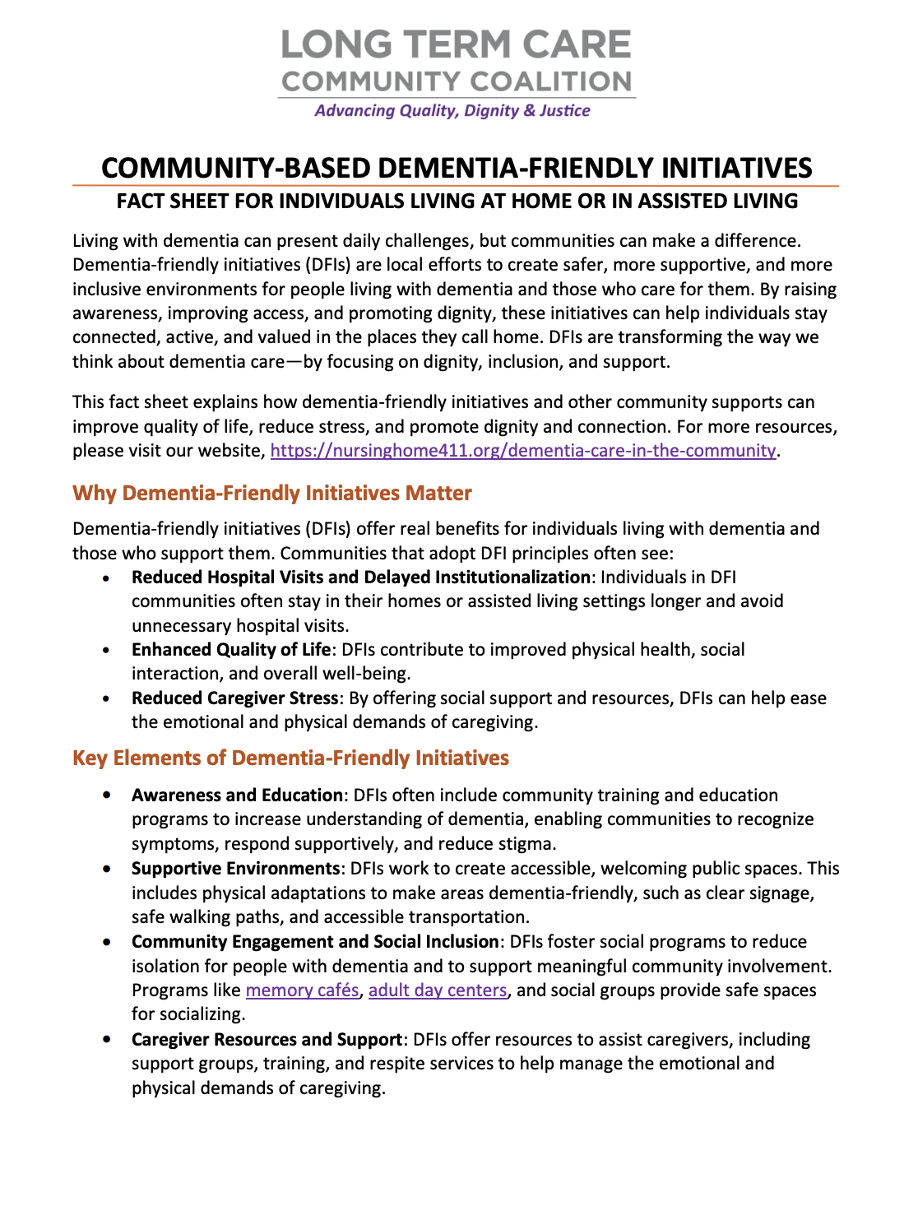
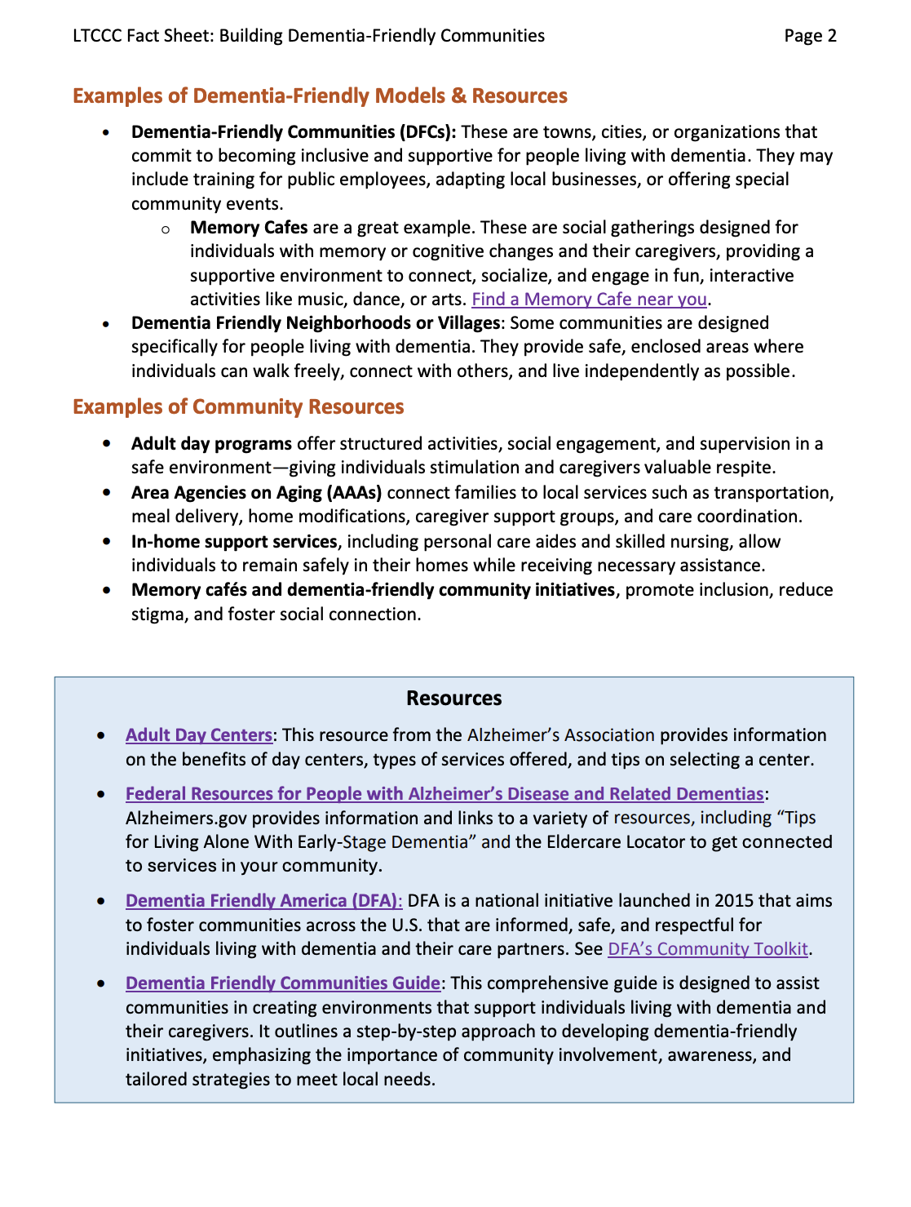

Slide 10
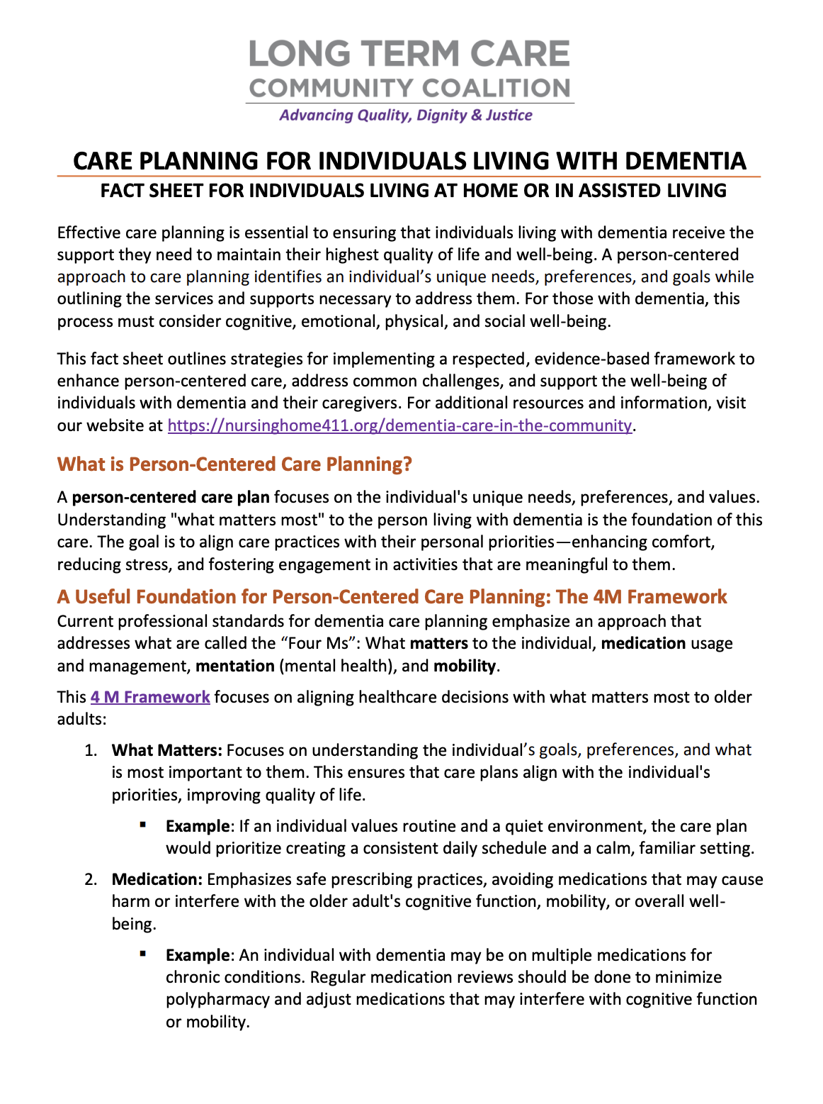
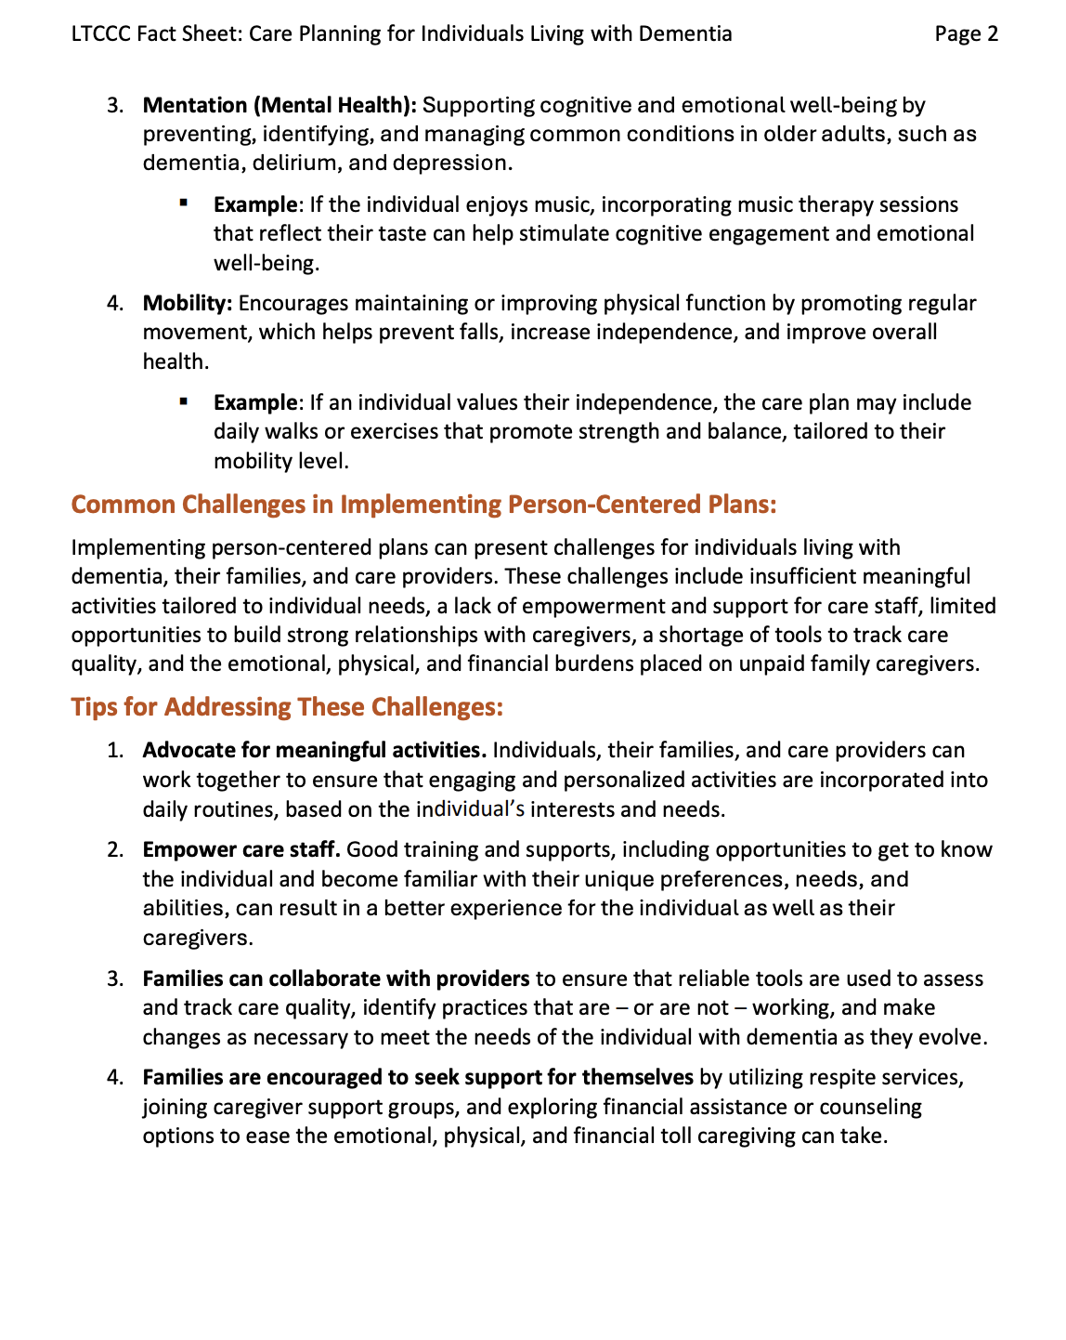

Slide 11
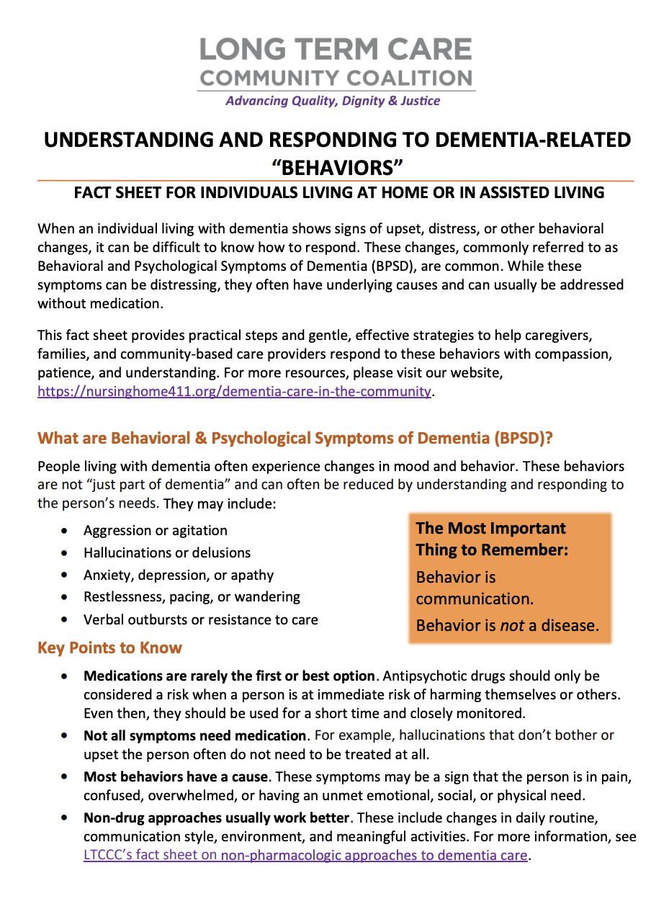
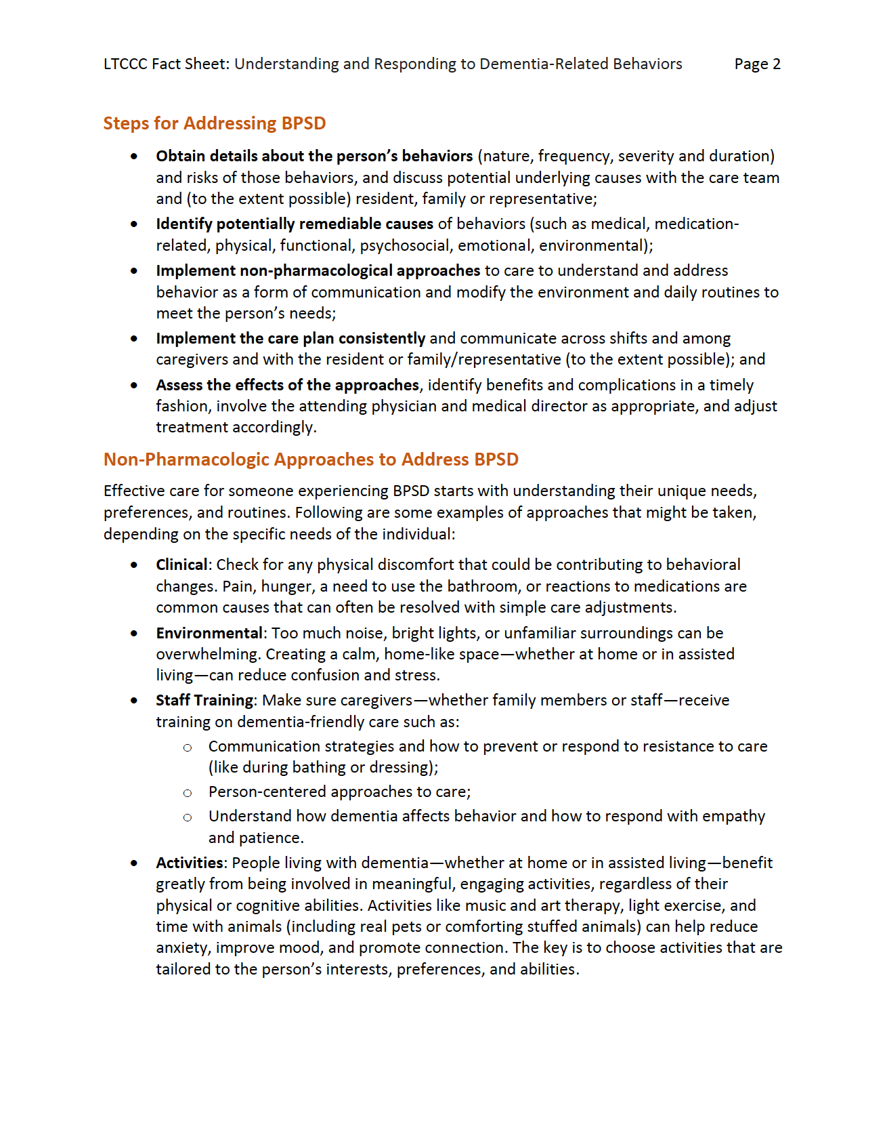

Slide 12
How Legislators Can Use Fact Sheets
Provide constituents and families with trusted guidance during emotionally challenging situations
Support conversations about behavior changes, safety concerns, and care planning
Help constituents and families better understand dementia-related symptoms and communication changes
Reinforce recommendations around home care, assisted living, and next steps

Slide 13
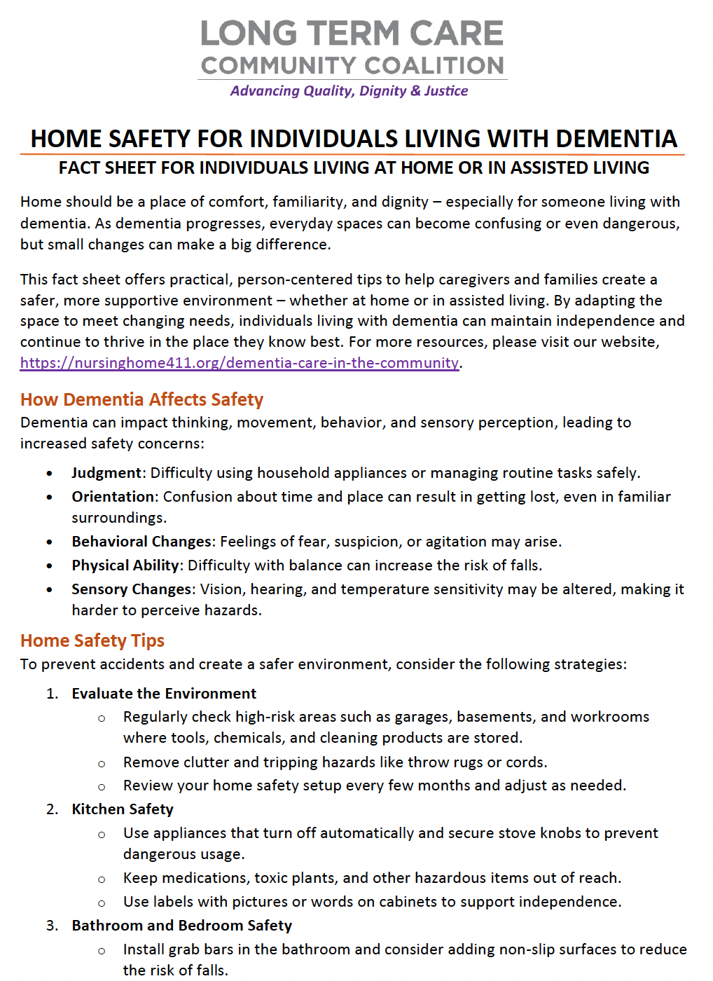
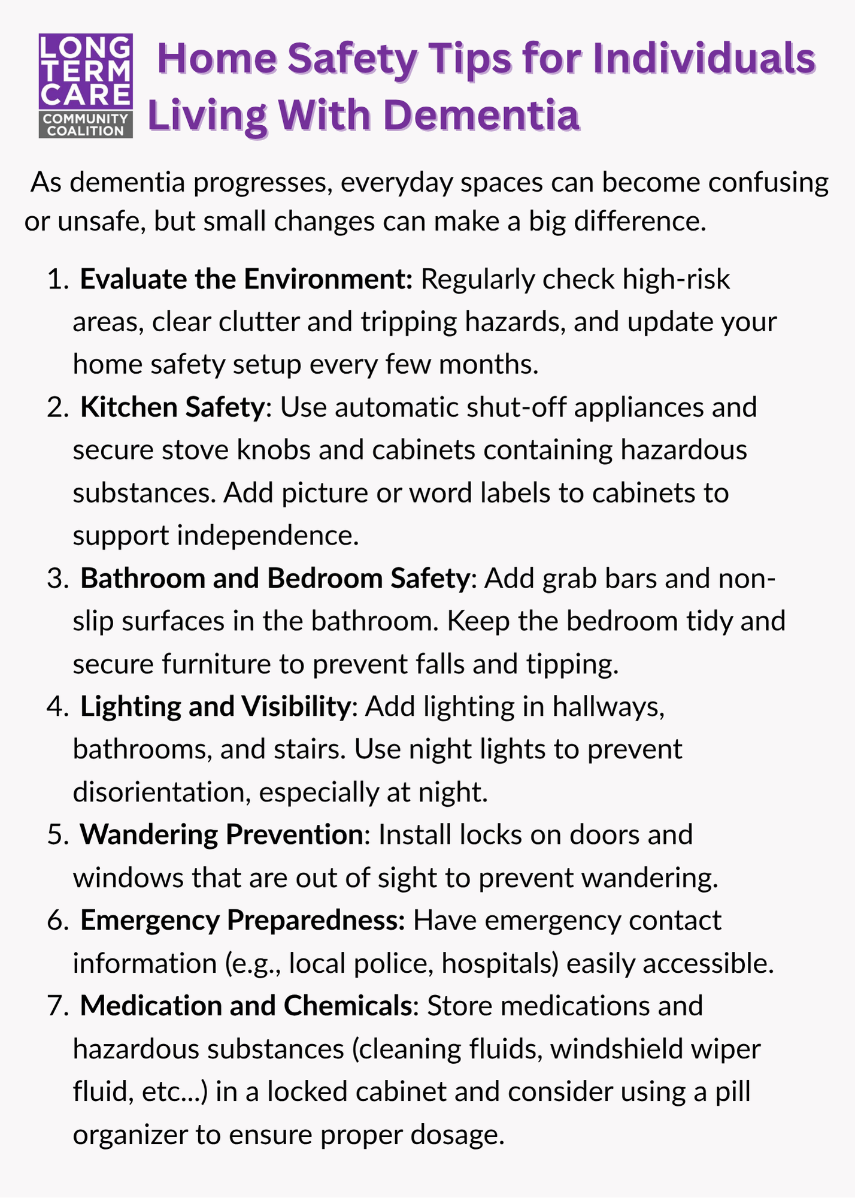
Care Cards: What They Provide
Quick, easy-to-read tips for everyday caregiving situations
Designed for real-life moments when immediate guidance is needed
Mobile-friendly – can be saved or accessed on a phone
Focus on simple, actionable strategies

Slide 14
How Legislators Can Use Care Cards
Provide quick, easy-to-share tips for families experiencing stress or crisis situations
Offer mobile-friendly resources constituents can save directly to their phones
Use during community events, caregiver outreach, and constituent meetings
Share practical guidance families can use immediately at home

Slide 15
Mini-Modules: What They Provide
Short, focused educational videos
Designed for busy caregivers with limited time
Cover key caregiving topics in a simple, approachable way
Can be watched individually or shared in group settings

Slide 16
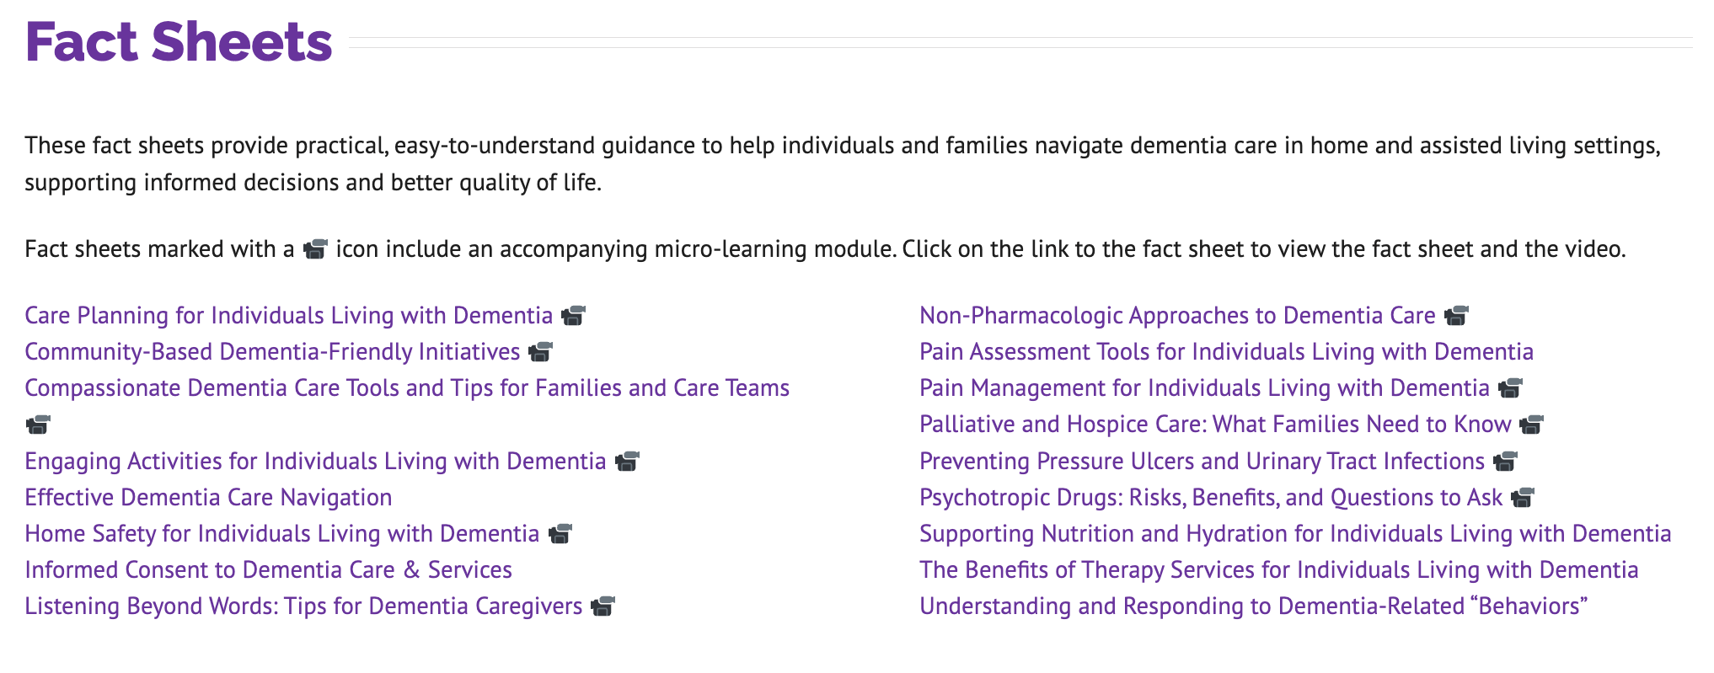

Slide 17
How Legislators Can Use Mini-Modules
Use brief videos to introduce key dementia care concepts to constituents and families and caregivers
Support staff education and reinforce person-centered care practices
Provide flexible learning tools during support groups, trainings, or outreach efforts
Encourage discussion around challenging caregiving situations and available supports

Slide 18
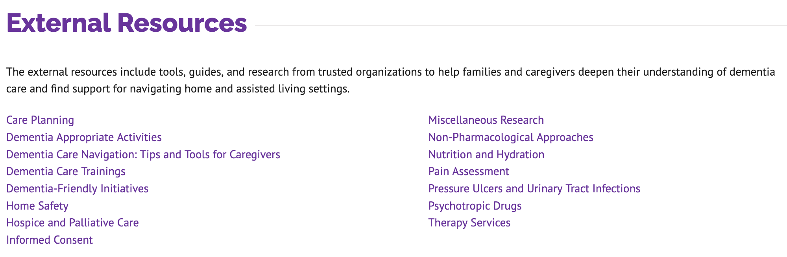
External Resource Library
All of the fact sheets and care cards are based on professional standards and expert research. The Toolkit page provides a curated list of these external resources for those looking to dig deeper.

Slide 19
Easy Ways Offices Can Use the Toolkit
Add the toolkit link to your district office website or resource page
Include toolkit materials in follow-up emails related to aging, caregiving, or long-term care
Share resources through newsletters, social media, and community outreach
Equip staff and interns with trusted information to support constituent conversations
Partner with local organizations serving older adults and caregivers

Slide 20
Suggested Staff or Intern Orientation Agenda (can be done in-person, via video conference, or hybrid)
Overview of dementia caregiving challenges facing constituents
Introduction to the LTCCC toolkit and available resources
Review common constituent concerns related to long-term care
Watch a short mini-module video together
Discuss referral strategies and community outreach opportunities

Slide 21
Discussion Questions
What caregiving concerns do constituents contact your office about most often?
What dementia-related situations create the greatest stress for families?
How can district offices improve resource-sharing and caregiver outreach?
What community partnerships could strengthen support for caregivers?

Slide 22
Implementation Ideas
Add toolkit resources to constituent service materials
Highlight caregiver resources during Older Americans Month and caregiver awareness campaigns
Share care cards and fact sheets at community events and senior fairs
Include dementia resources in district newsletters and websites
Use materials to support conversations with local aging and long-term care organizations

Slide 23
Key Messages for Legislators & Staff
Dementia caregiving affects families across every community
Caregivers are often overwhelmed and unsure where to turn
Behavior changes are common and often misunderstood
Trusted educational resources can reduce stress and improve safety
Small acts of support and connection can make a meaningful difference for constituents

Slide 24
Next Steps
Explore the toolkit
Nursinghome411.org/dementia-care-in-the-community
Add the toolkit to your office’s constituent resource materials
Share resources with staff, interns, and community partners
Identify opportunities for caregiver outreach
Visit www.nursinghome411.org for additional aging and long-term care resources

Slide 25
Thank you!
Questions?
Comments?
nursinghome411.org

