Slide 1

Empowering Employees with dementia care resources
Long Term Care Community Coalition
nursinghome411.org

Slide 2
The Long Term Care Community Coalition
LTCCC: Nonprofit, nonpartisan organization dedicated to improving care & quality of life for the elderly & adult disabled in long-term care (LTC).
Our focus: People who live in nursing homes & assisted living.
What we do:
Policy analysis and systems advocacy;
Data resources & analyses;
Education of consumers and families, LTC ombudsmen, and other stakeholders;
Home of two local LTC Ombudsman Programs in the Hudson Valley, New York
Website: www.nursinghome411.org
Range of free resources on nursing home and assisted living care

Slide 3
Training Goals
Understand the impact of dementia caregiving on employees
Introduce workplace-friendly dementia resources
Facilitate conversations and support sessions
Integrate tools into HR, wellness, and ERG programs

Slide 4
Why This Matters
Millions of employees are caregivers for someone with dementia
Many are balancing full-time work + caregiving responsibilities
Often invisible in the workplace
Without support, employees may struggle silently

Slide 5
Impact on the Workplace
High stress, fatigue, and burnout
Frequent interruptions and schedule changes
Reduced focus and productivity
Workforce attrition

Slide 6
The Employer Opportunity
Reduce disruptions
Strengthen wellness programs
Support DEI and family-friendly policies
Improve retention

Slide 7
Introducing the LTCCC Toolkit
Free, online resource available at NursingHome411.org
Designed for caregivers
Available in English and Spanish
Supports person-centered dementia care

Slide 8
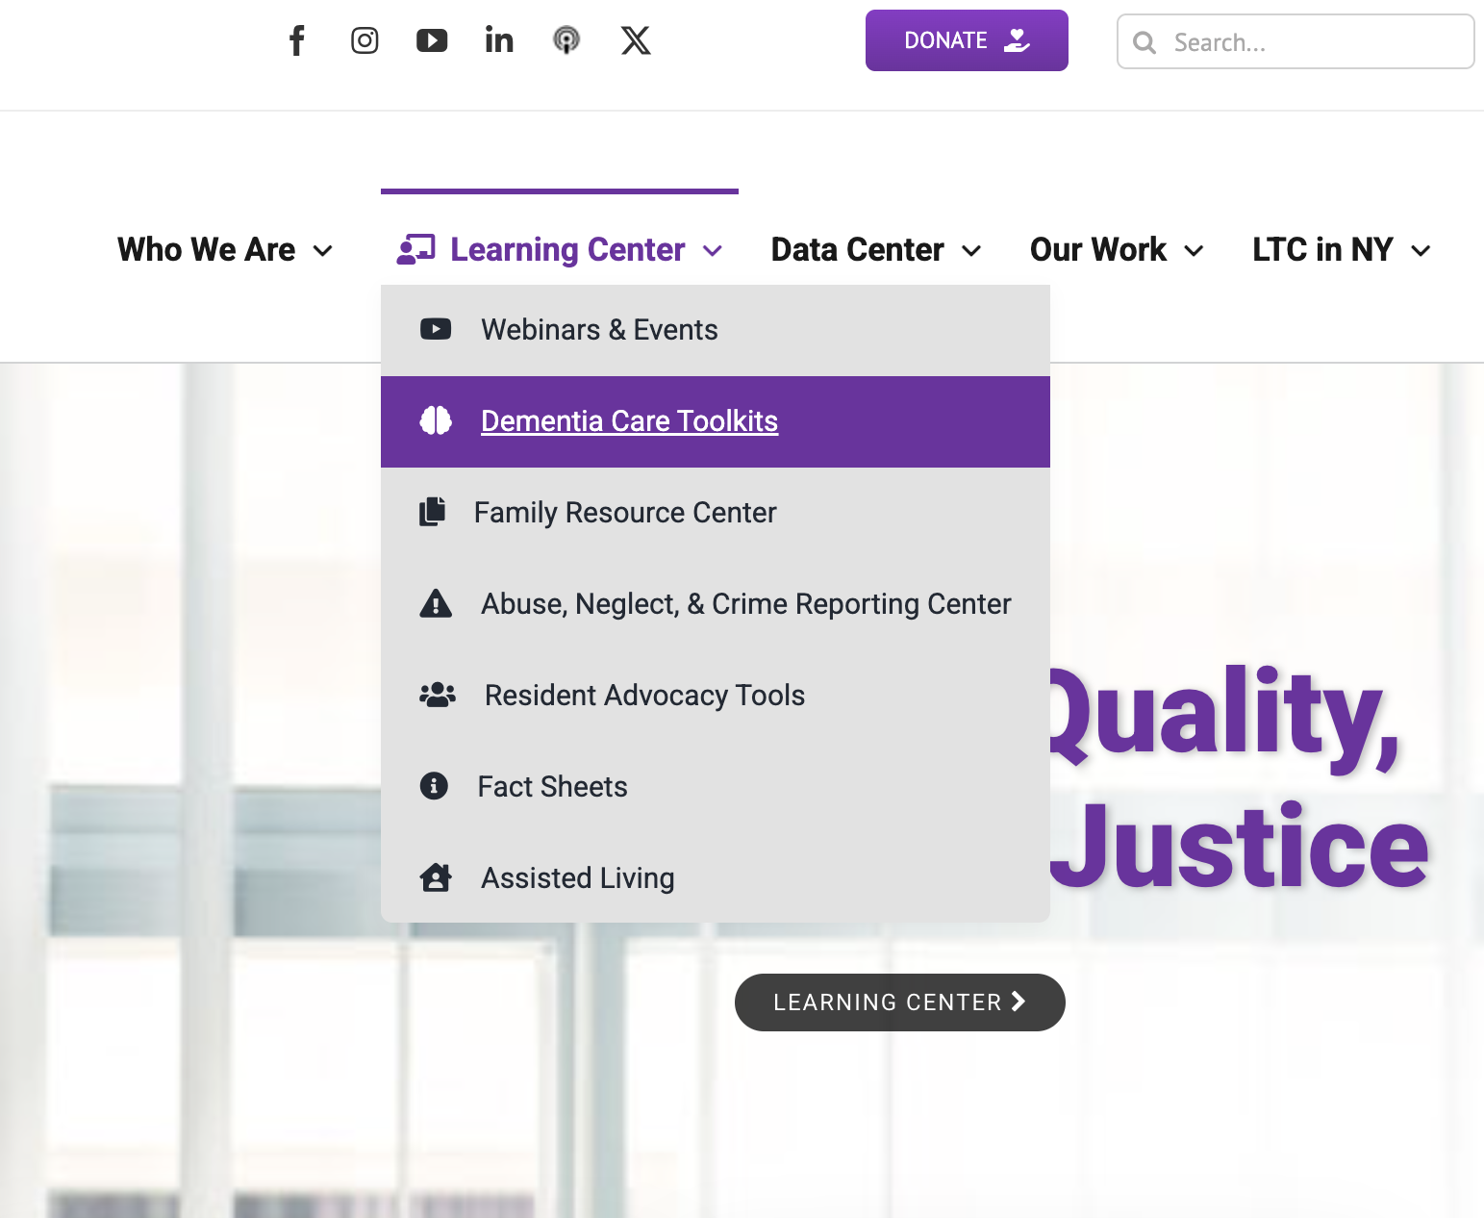
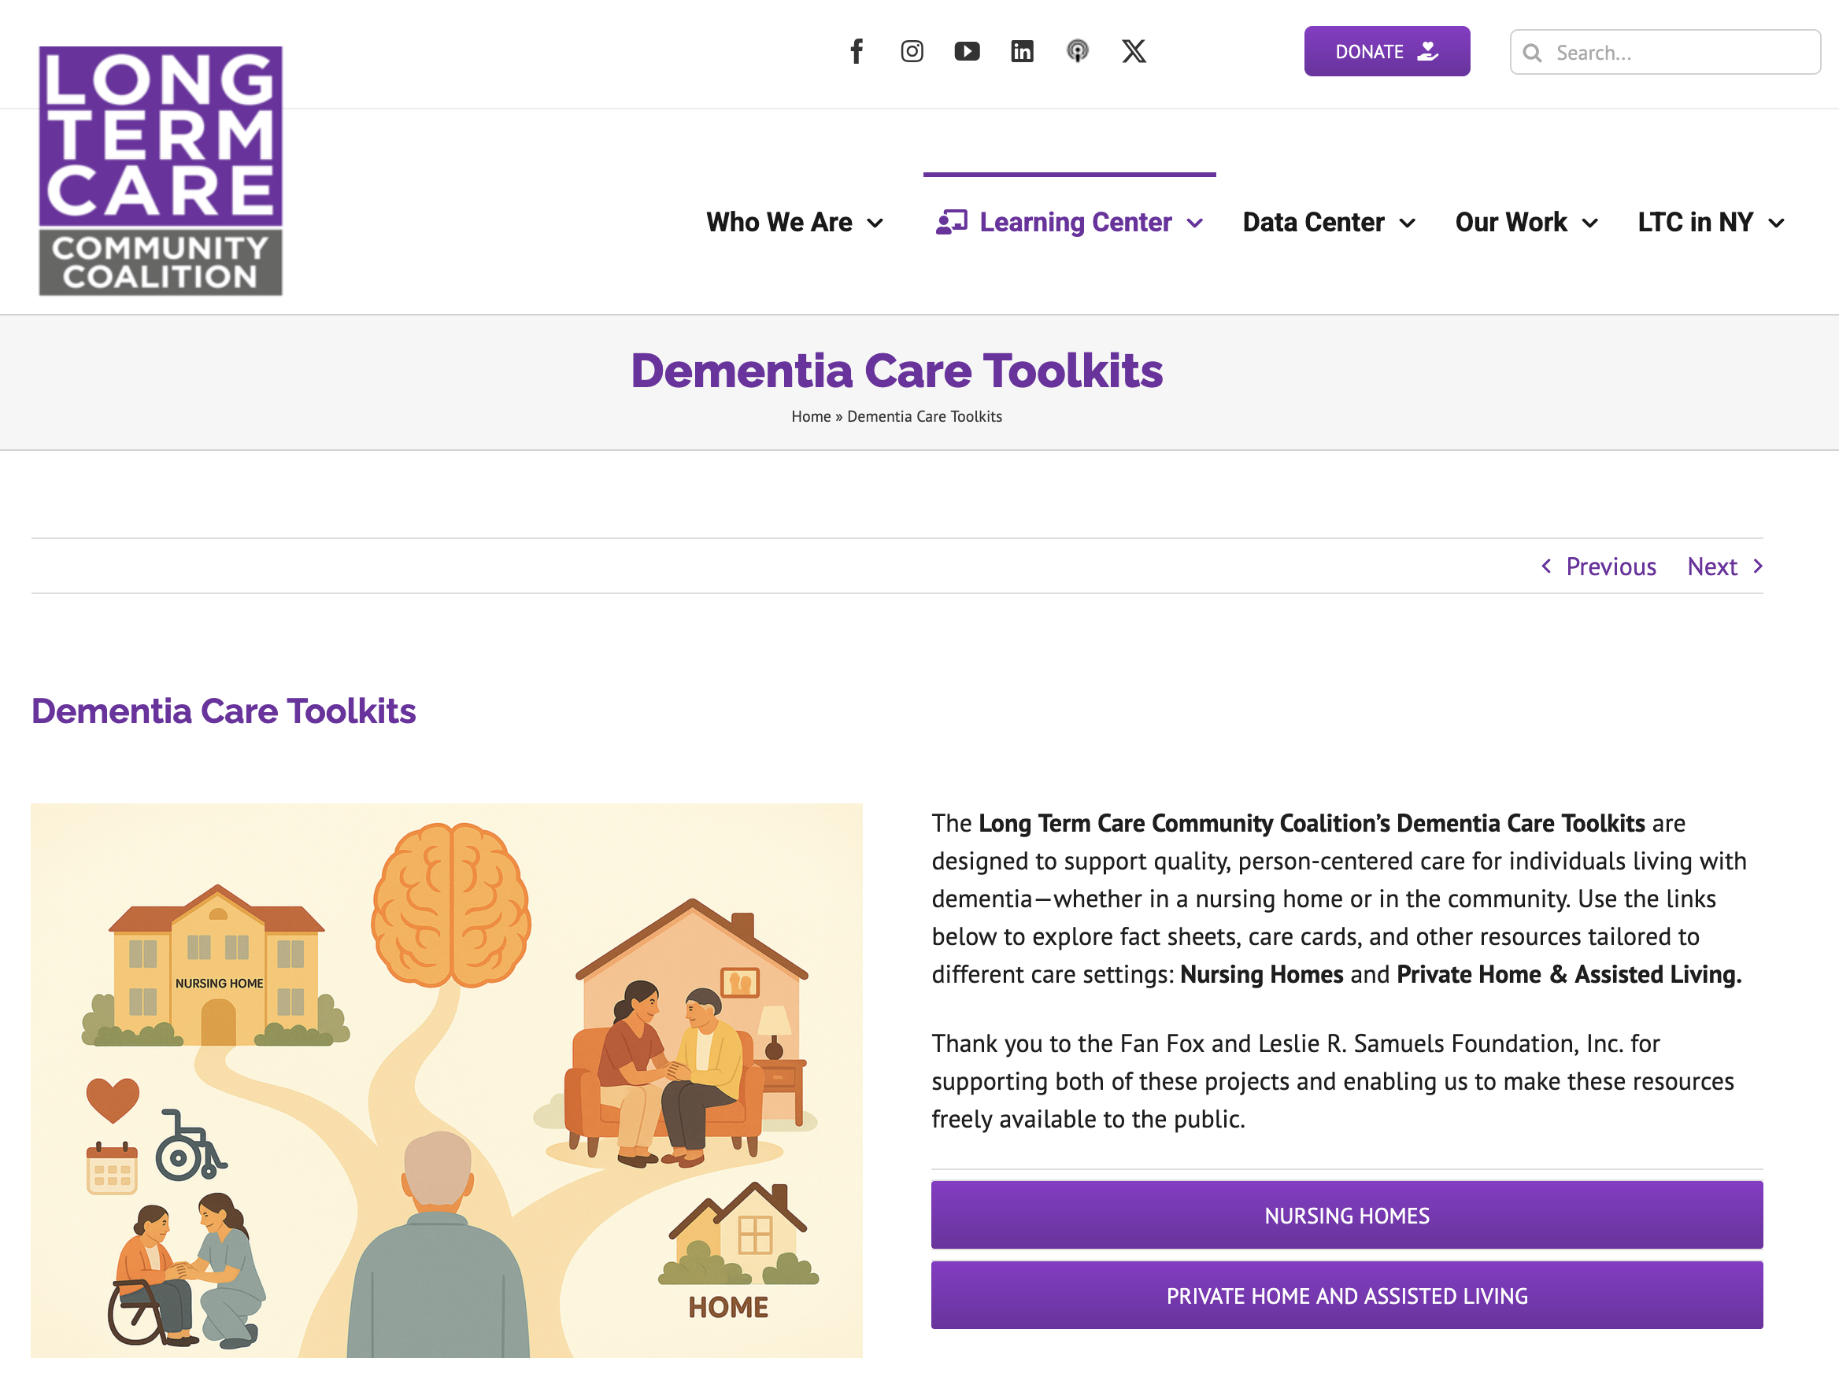
Accessing the Toolkit
Visit nursinghome411.org
Accessible via phone, tablet, or computer
No login or subscription required
Easy to share with staff

Slide 9
What’s Inside the Toolkit
Fact Sheets: provide deeper but user-friendly information on dementia topics
Care Cards: quick, practical tips for real-time situations
Mini-Modules: short videos for learning and group discussion
External resources for deeper learning

Slide 10
Fact Sheets: What They Provide
Clear, plain-language guidance on dementia and caregiving
Designed for family members and non-professional caregivers
Helps employees better understand what their loved one is experiencing
Topics include:
Care planning
Home Safety
Pain Assessment Tools
Preventing Pressure Ulcers and Urinary Tract Infections
Understanding and Responding to Dementia-Related “Behaviors”
Palliative and Hospice Care: What Families Need to Know
Psychotropic Drugs: Risks, Benefits, and Questions to Ask

Slide 11
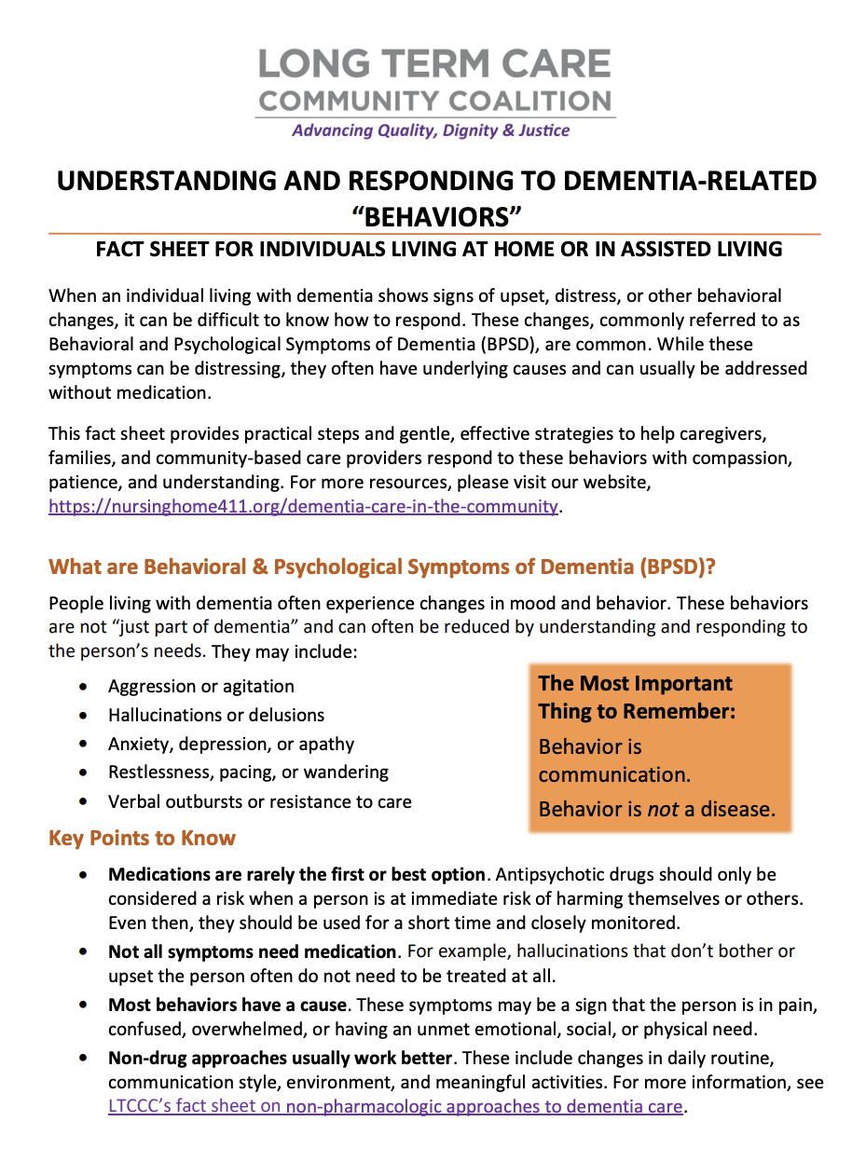
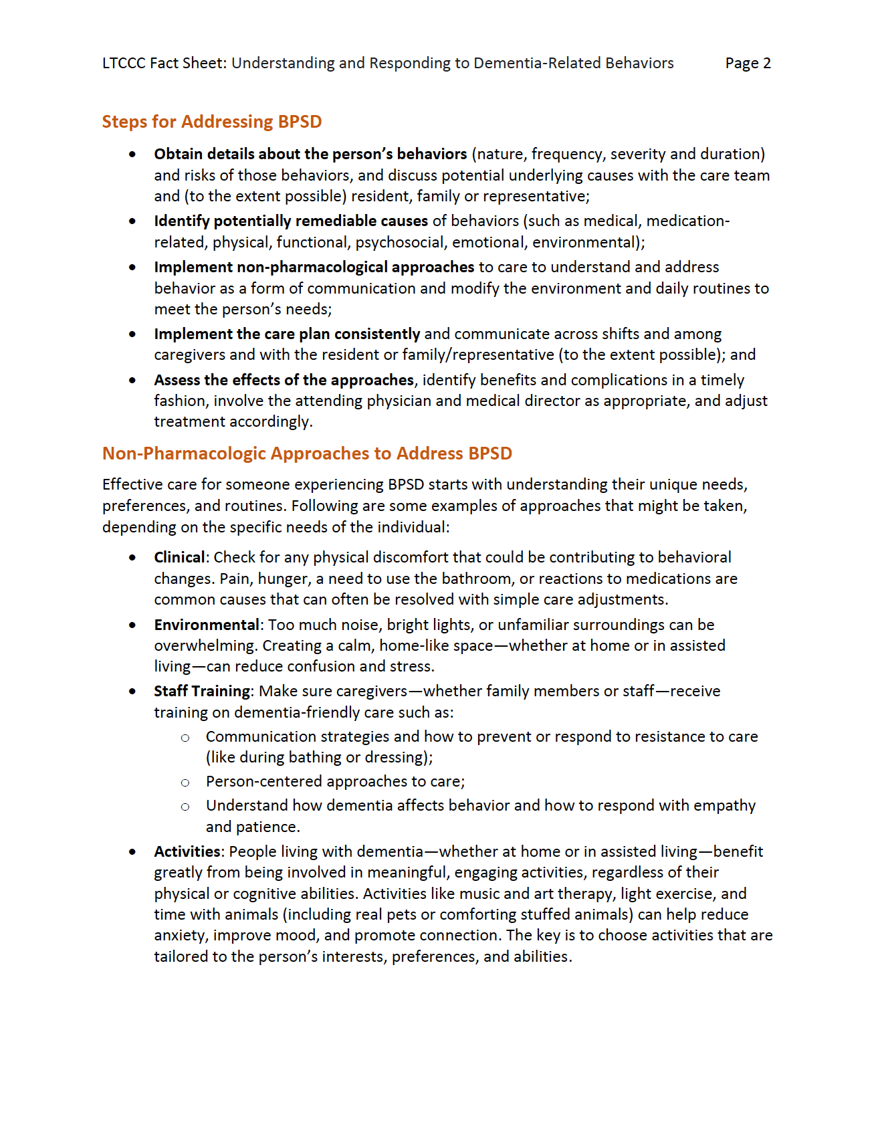

Slide 12
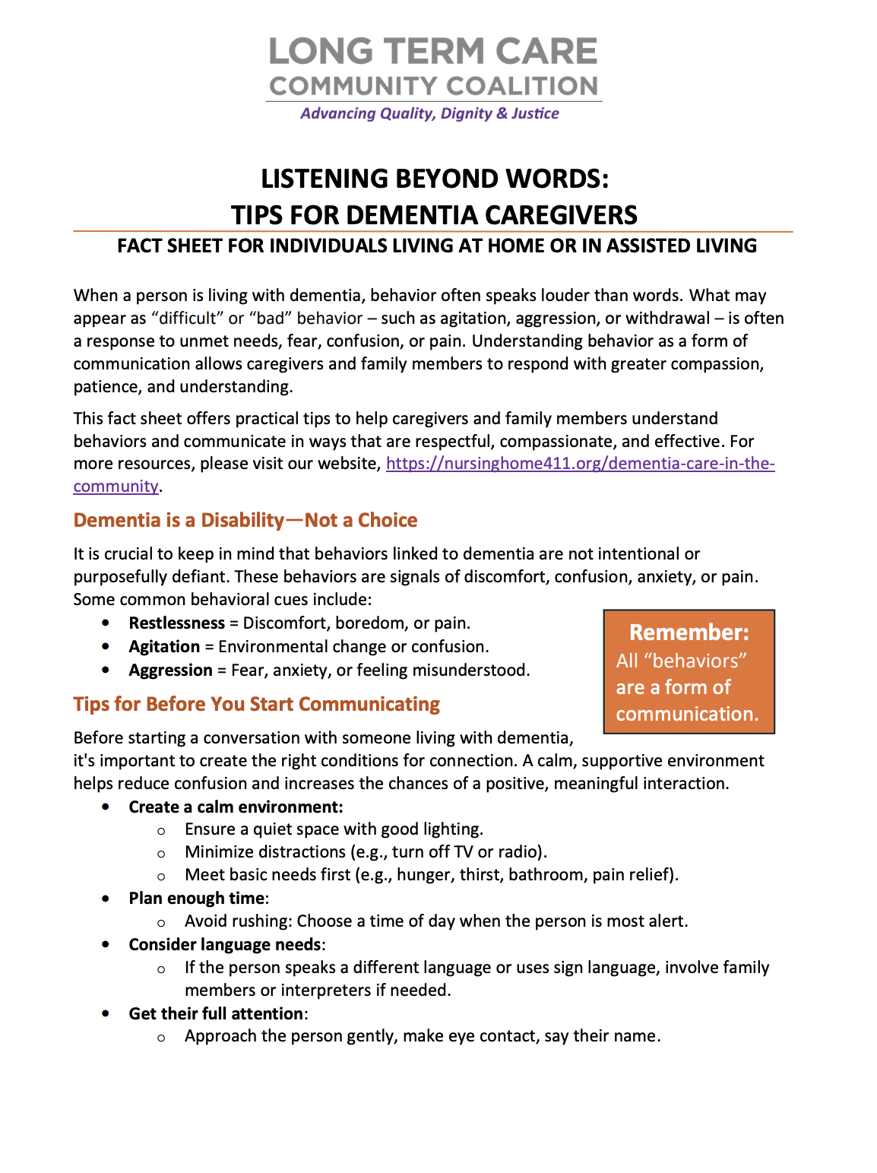
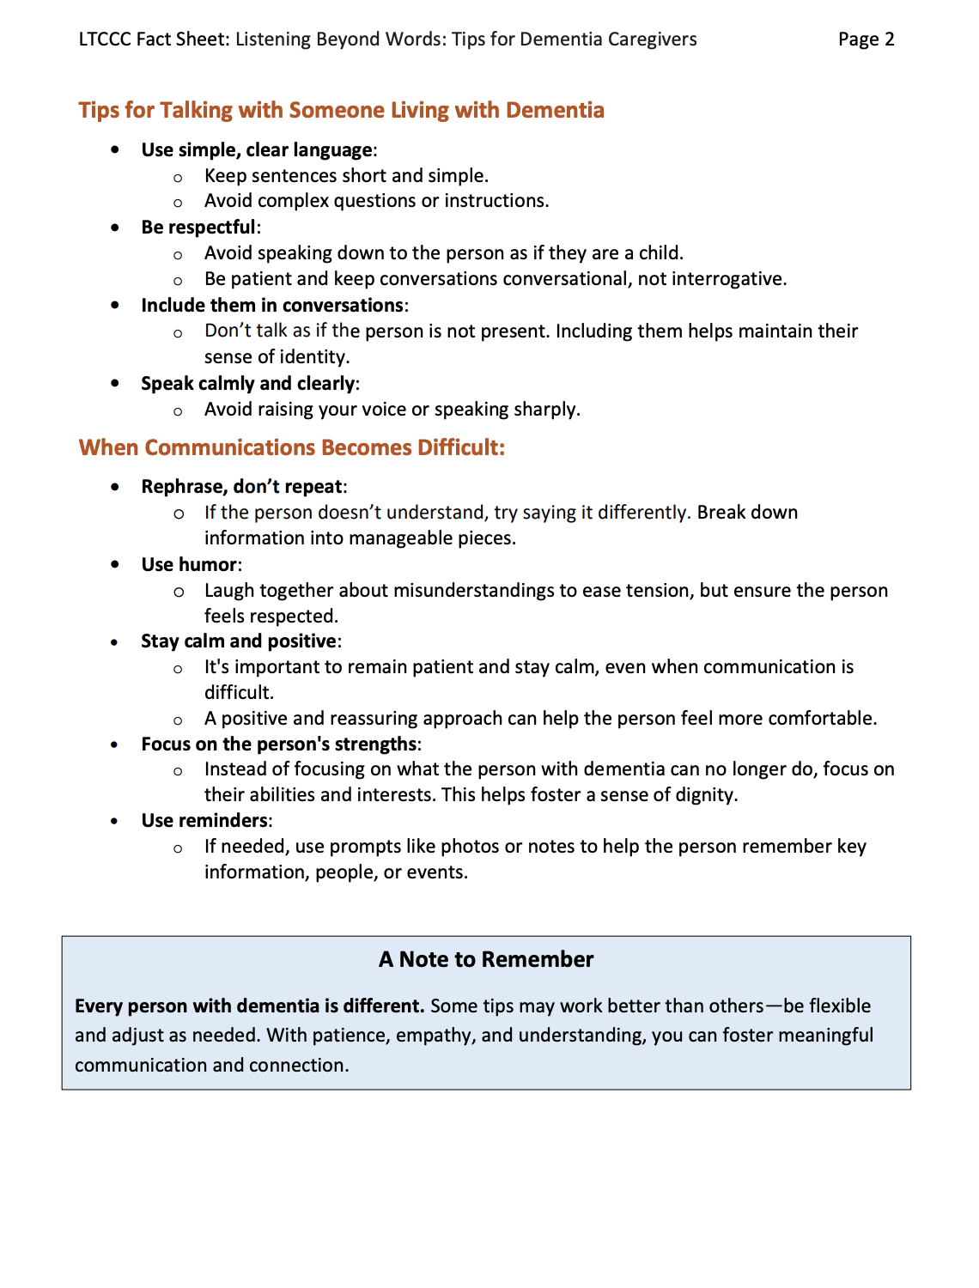

Slide 13
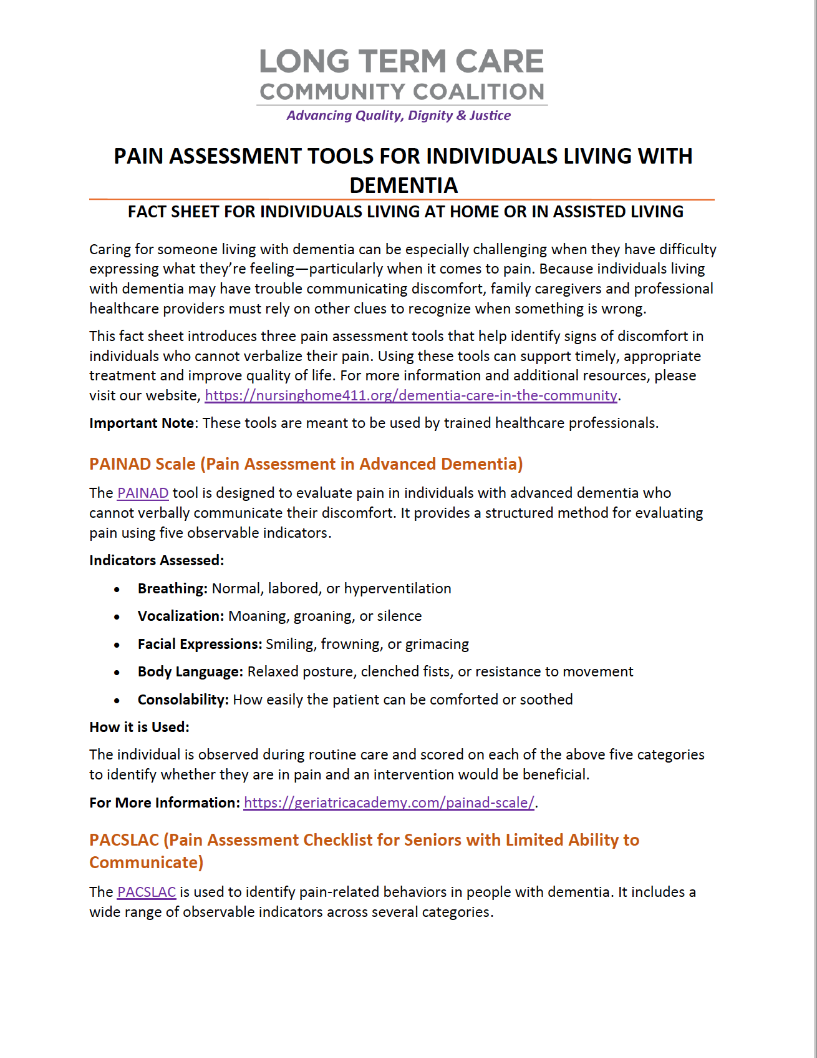
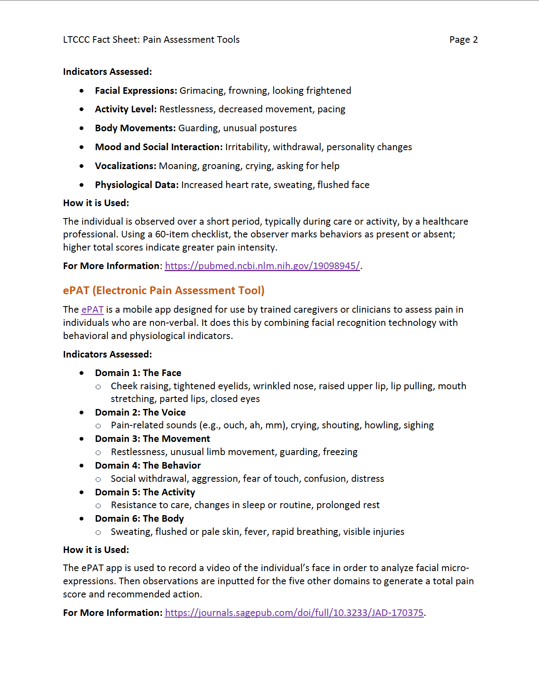

Slide 14
How Employees Can Use Fact Sheets
Learn practical strategies for managing common caregiving challenges
Prepare for doctor visits or care planning conversations
Better understand changes in behavior and communication
Share information with other family members to align care approaches

Slide 15
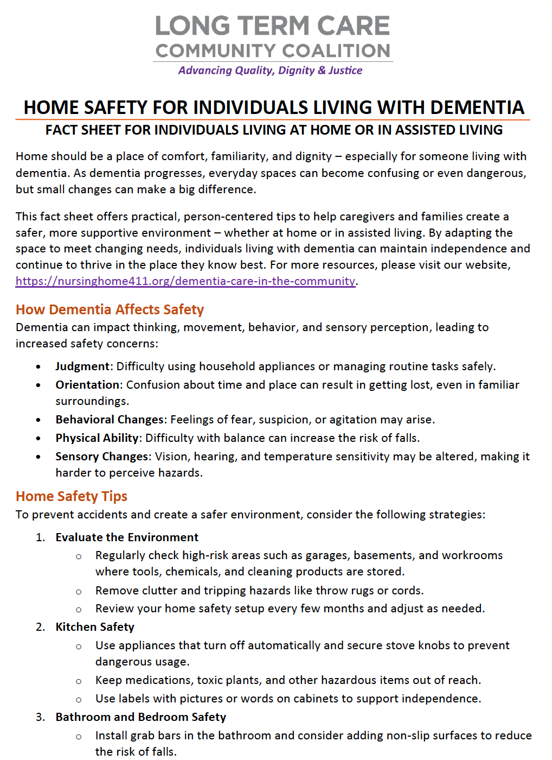
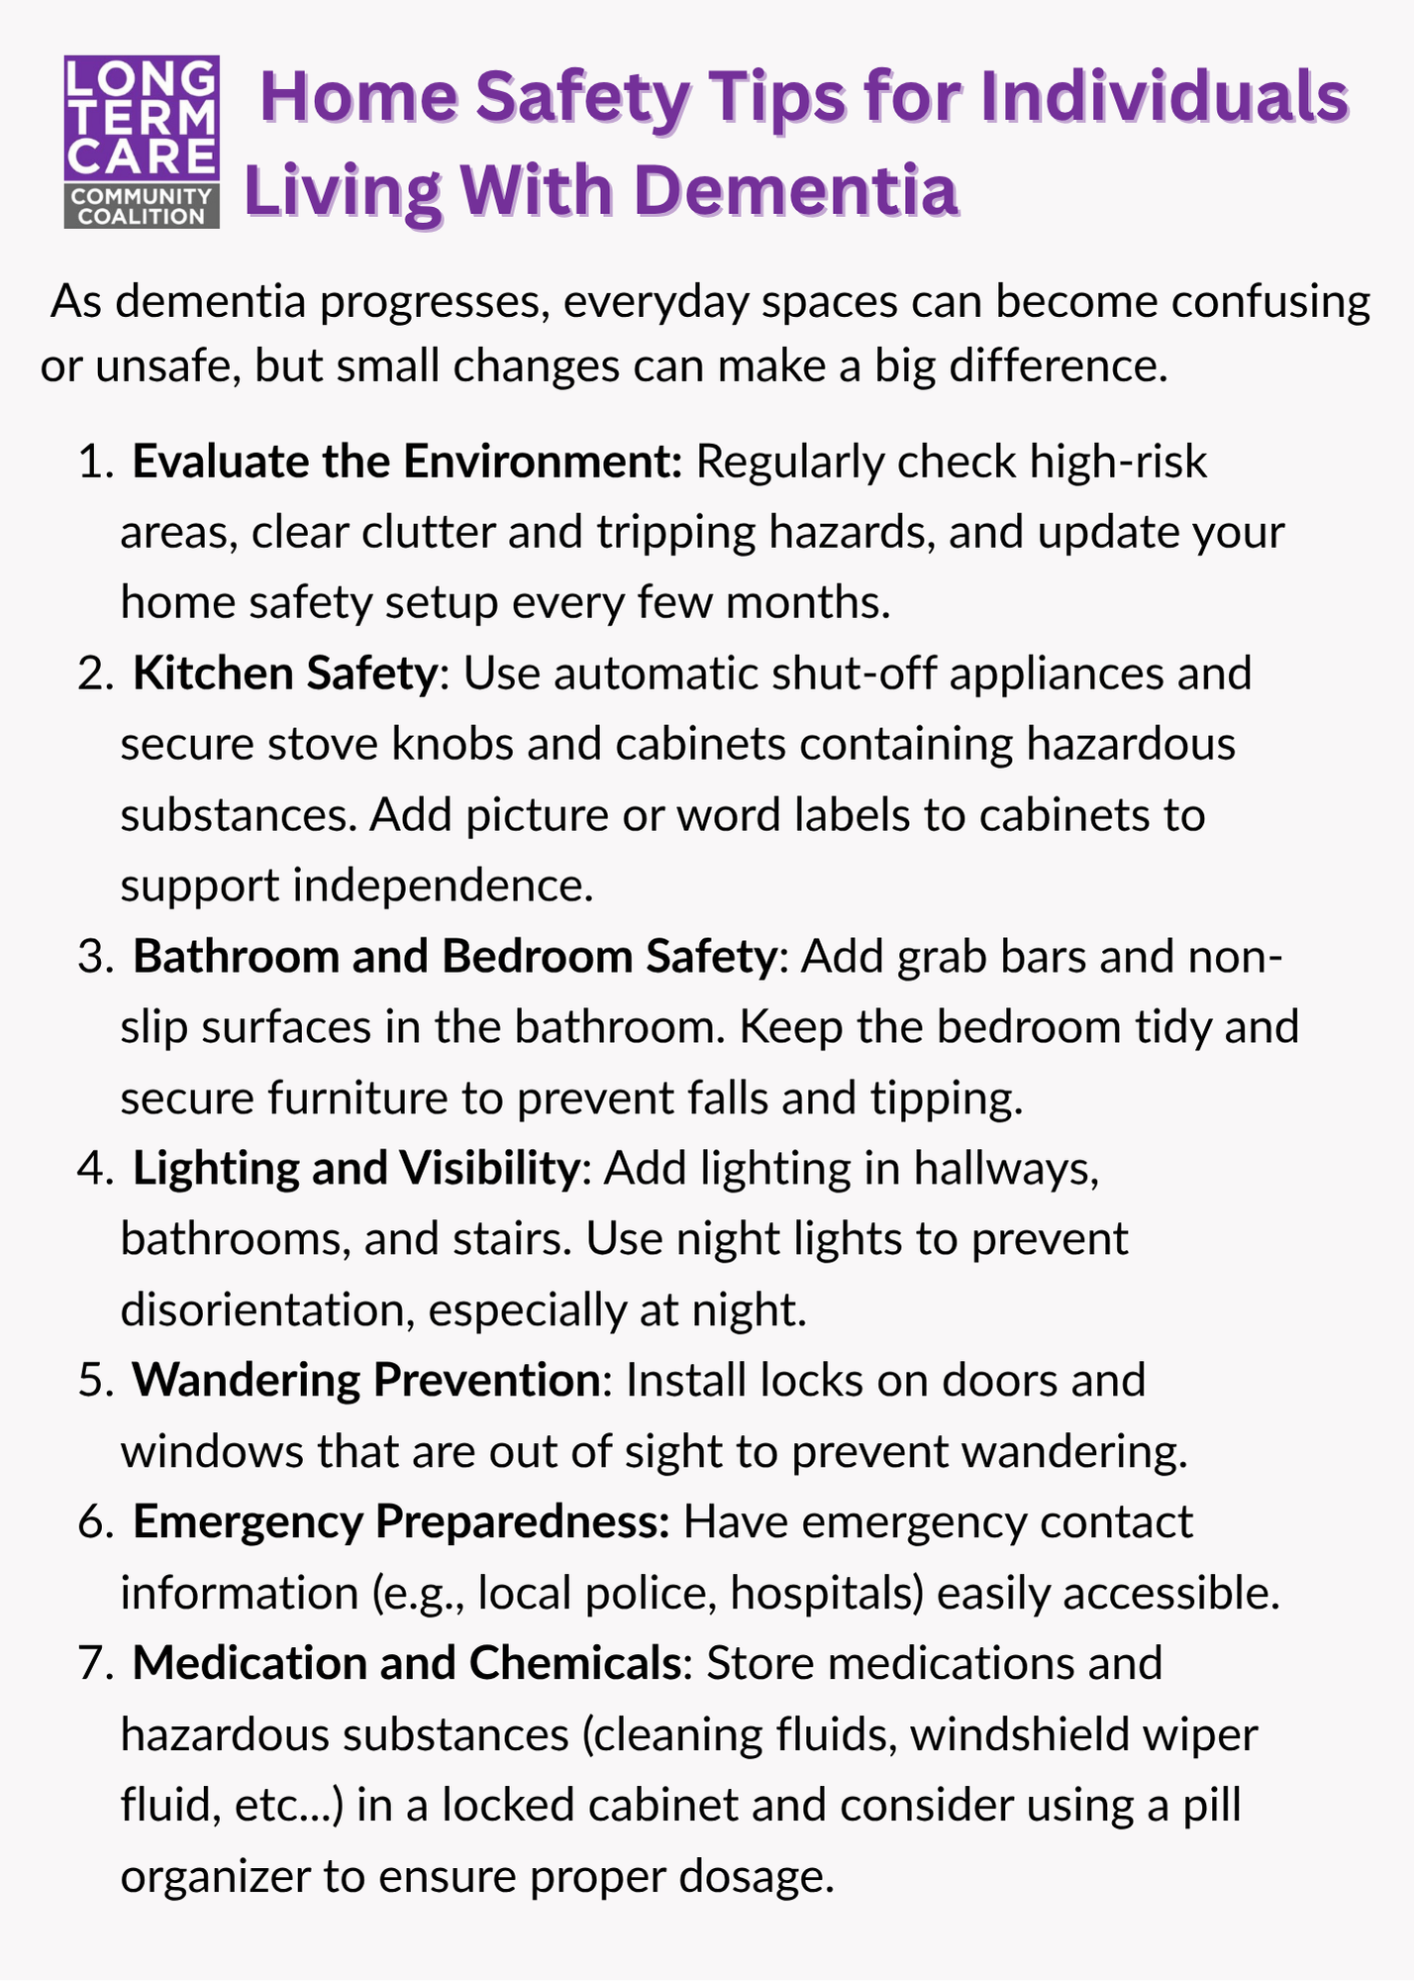
Care Cards: What They Provide
Quick, easy-to-read tips for everyday caregiving situations
Designed for real-life moments when immediate guidance is needed
Mobile-friendly – can be saved or accessed on a phone
Focus on simple, actionable strategies

Slide 16
How Employees Can Use Care Cards
Get quick guidance during challenging moments (e.g., agitation, confusion)
Build confidence in responding to difficult situations
Keep tips handy on their phone for easy access anytime
Share with other family members involved in caregiving

Slide 17
Mini-Modules: What They Provide
Short, focused educational videos
Designed for busy employees with limited time
Cover key caregiving topics in a simple, approachable way
Can be watched individually or shared in group settings

Slide 18
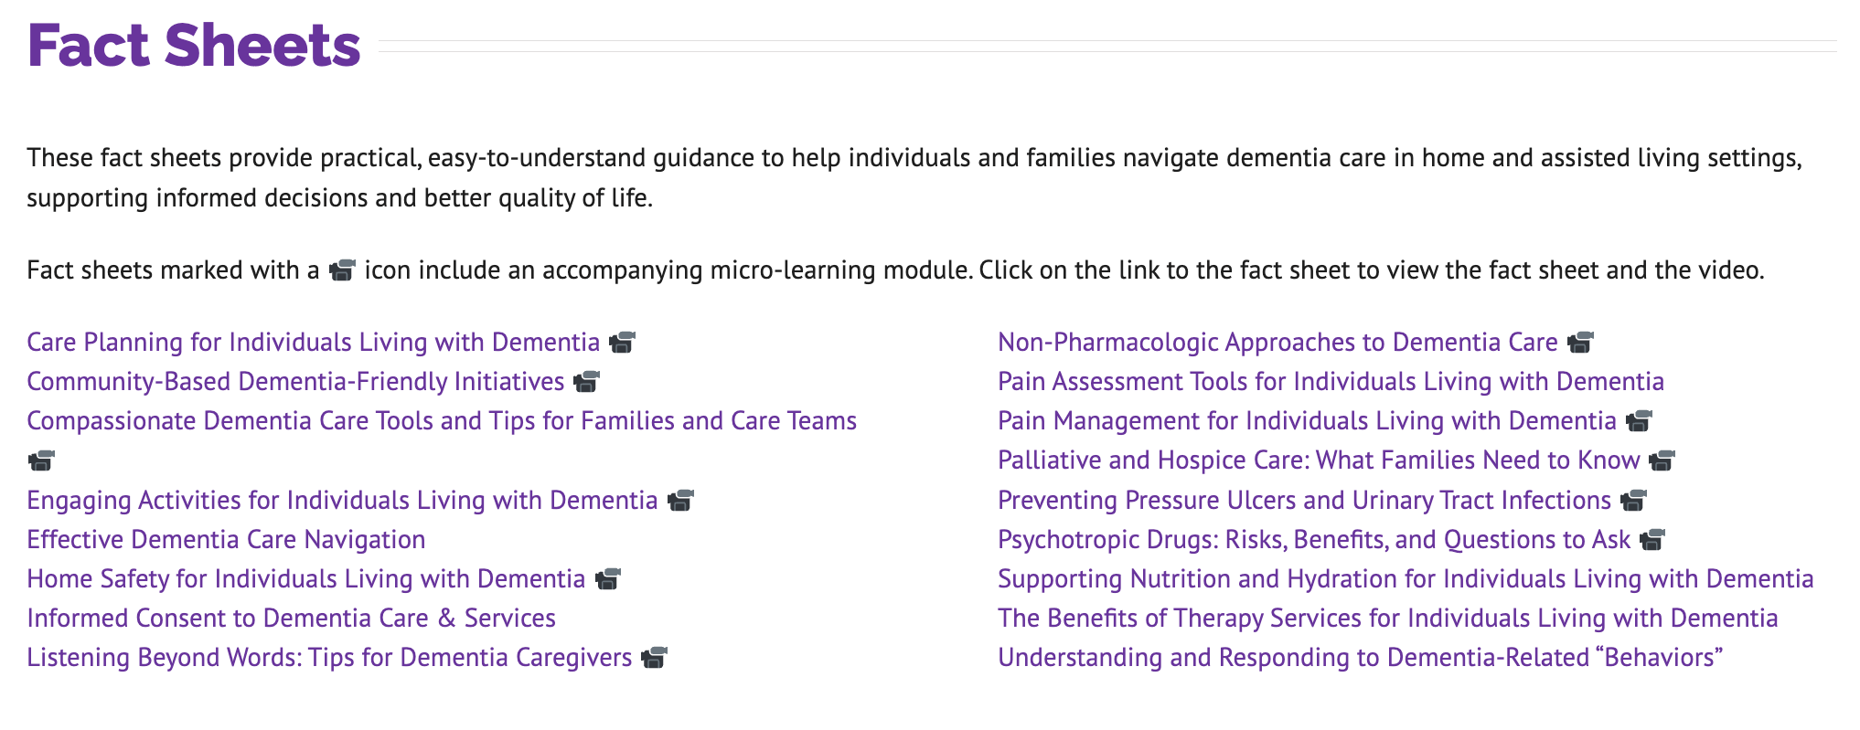

Slide 19
How Employees Can Use Mini-Modules
Watch short videos when they have time
Learn specific skills or strategies for caregiving situations
Share videos with family members or support networks
Use as a starting point for conversations with others

Slide 20
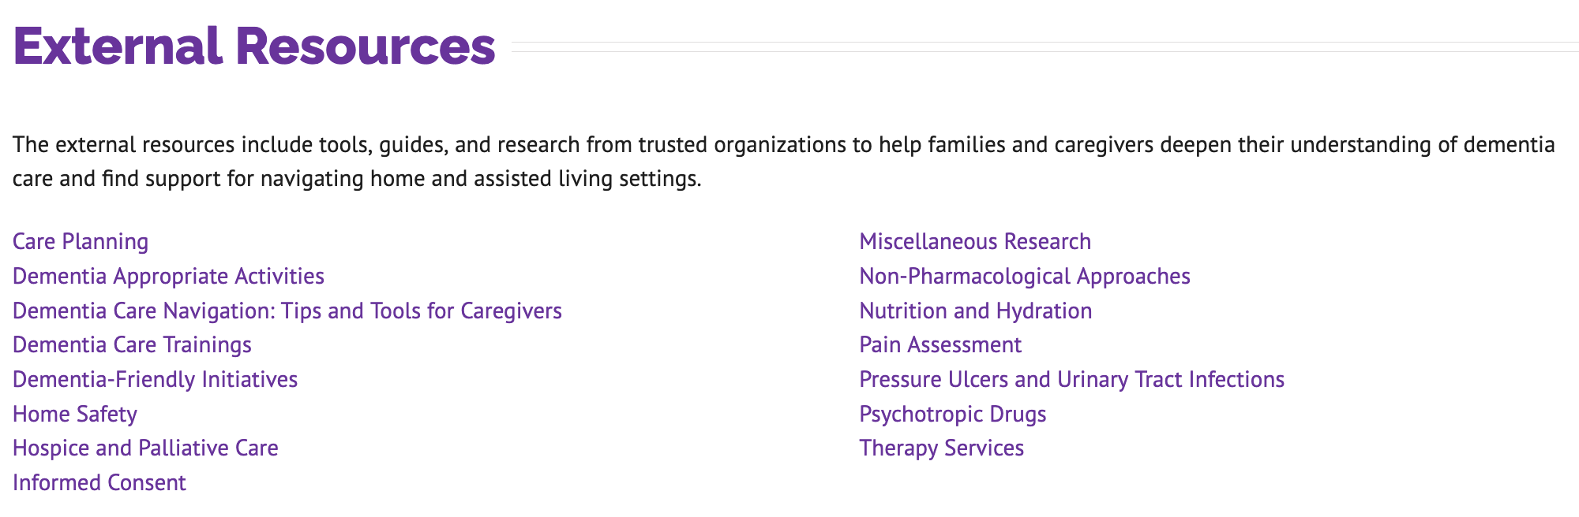
External Resource Library
All of the fact sheets and care cards are based on professional standards and expert research. The Toolkit page provides a curated list of these external resources for those looking to dig deeper.

Slide 21
Why Employees Benefit
Feel more confident in caregiving situations
Reduce crises and emergency situations
Improve communication with healthcare providers
Better balance caregiving and work responsibilities

Slide 22
Sample Agenda for Session for Employees (can be done in-person, via video conference, or hybrid)
Welcome and self-introductions of participants (if small group)
Acknowledge caregiving realities
Introduce toolkit
Walk through one or two of the resources
Show one of the mini-modules
Open discussion

Slide 23
Conversation Starters
“Does anyone here support a family member or loved one with memory loss?”
“What challenges have you faced balancing work and caregiving?”
“What support would make a difference?”

Slide 24
Implementation Ideas
Add toolkit to intranet
Include in HR emails or newsletters
Share in employee resource groups or caregiver groups
Integrate into employee assistance programs or wellness programs
Share a “Care Card of the Month”
Highlight during awareness months
Offer a lunch & learn

Slide 25
Tips for Reducing Stigma
Normalize caregiving conversations
Emphasize confidentiality
Avoid making assumptions
Lead with empathy

Slide 26
Next Steps
Explore the toolkit
Nursinghome411.org/dementia-care-in-the-community
Share at least one resource this week
Plan a conversation or session
Additional resources available through LTCCC

Slide 27
Thank you!
Questions?
Comments?
nursinghome411.org

