Slide 1

Supporting Dementia Care in Faith Communities
Long Term Care Community Coalition
nursinghome411.org

Slide 2
The Long Term Care Community Coalition
LTCCC: Nonprofit, nonpartisan organization dedicated to improving care & quality of life for the elderly & adult disabled in long-term care (LTC).
Our focus: People who live in nursing homes & assisted living.
What we do:
  Policy analysis and systems advocacy;
  Data resources & analyses;
  Education of consumers and families, LTC ombudsmen, and other stakeholders;
  Home of two local LTC Ombudsman Programs in the Hudson Valley, New York
Website: www.nursinghome411.org

Slide 3
Training Goals
Understand the caregiver experience within your community
Learn what is included in the LTCCC Dementia Care Toolkit
Practice how to use and share the toolkit resources in real situations
Leave with a simple, actionable plan to support caregivers

Slide 4
Why This Matters
Many caregivers are already part of your congregation – often quietly balancing caregiving, work, family, and spiritual life
Without support, caregivers may experience burnout and isolation
Faith communities can play a crucial role in reducing that isolation

Slide 5
The Gap We’re Addressing
Caregivers often don’t know where to find clear, trustworthy guidance
Information online can feel overwhelming or too clinical
Faith leaders are trusted – but may not feel equipped with dementia-specific knowledge
The toolkit provides simple, practical guidance for real situations

Slide 6
Introducing the LTCCC Toolkit
Free, online resource available at NursingHome411.org
Designed for caregivers, families, and community members
Available in English and Spanish
Focused on real-life caregiving situations

Slide 7
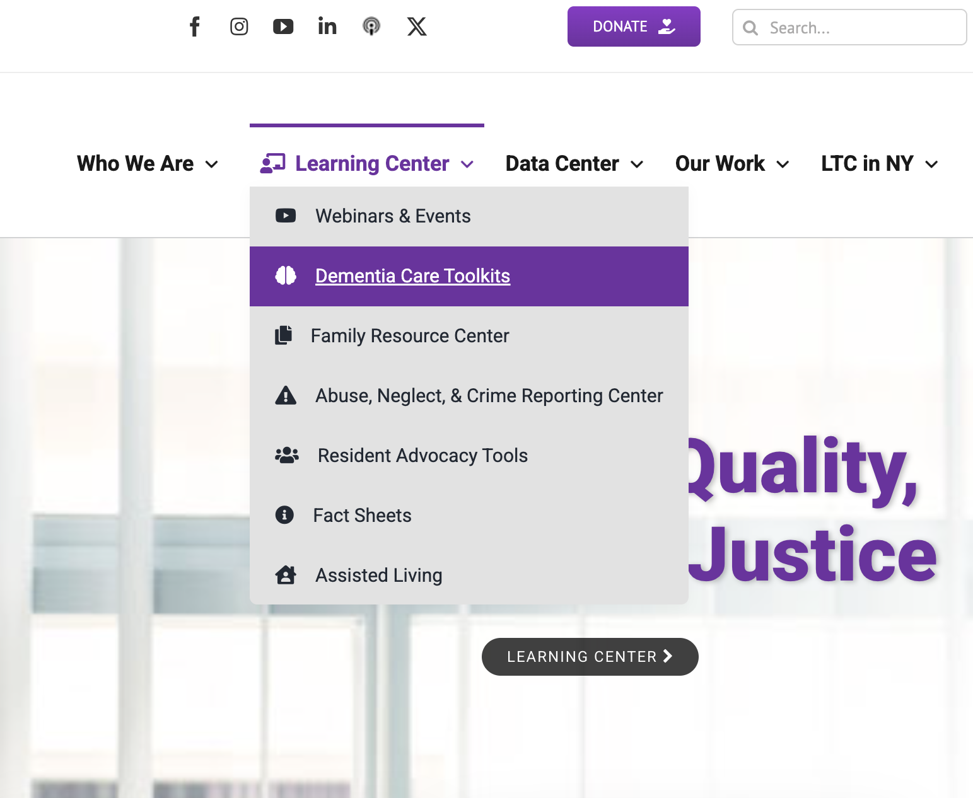
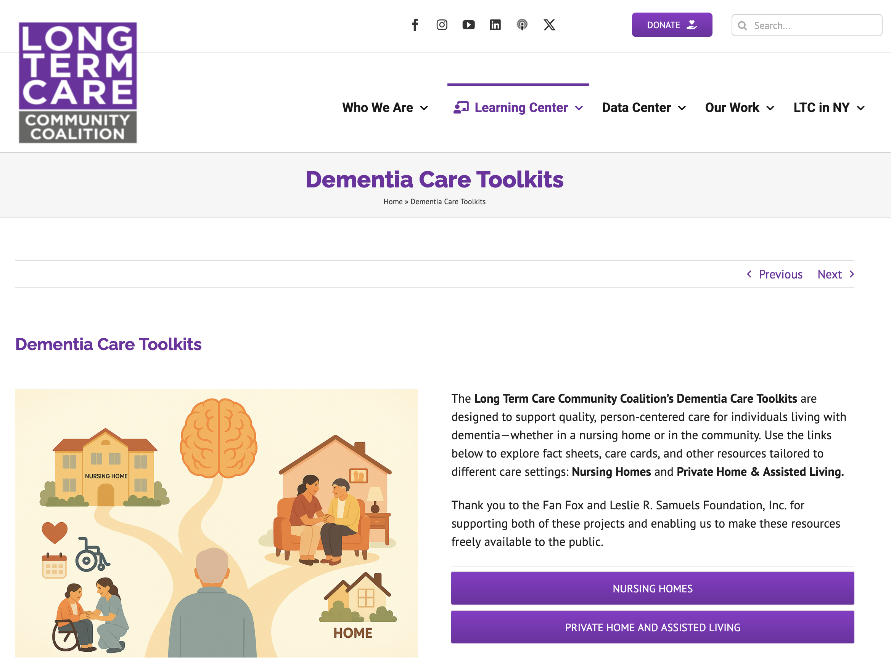

Slide 8
How the Toolkit is Organized
Fact Sheets: provide deeper but user-friendly information on dementia topics
Care Cards: quick, practical tips for real-time situations
Mini-Modules: short videos for learning and group discussion
Designed so you can choose what works best for your setting

Slide 9
Fact Sheets: What They Provide
Clear explanations of common dementia care challenges
Written in plain language – no medical background needed
Useful for both individual learning and group teaching
Topics include:
  Care planning
  Engaging Activities
  Home Safety
  Pain Assessment Tools
  Preventing Pressure Ulcers and Urinary Tract Infections
  Understanding and Responding to Dementia-Related “Behaviors”
  Palliative and Hospice Care: What Families Need to Know
  Psychotropic Drugs: Risks, Benefits, and Questions to Ask

Slide 10
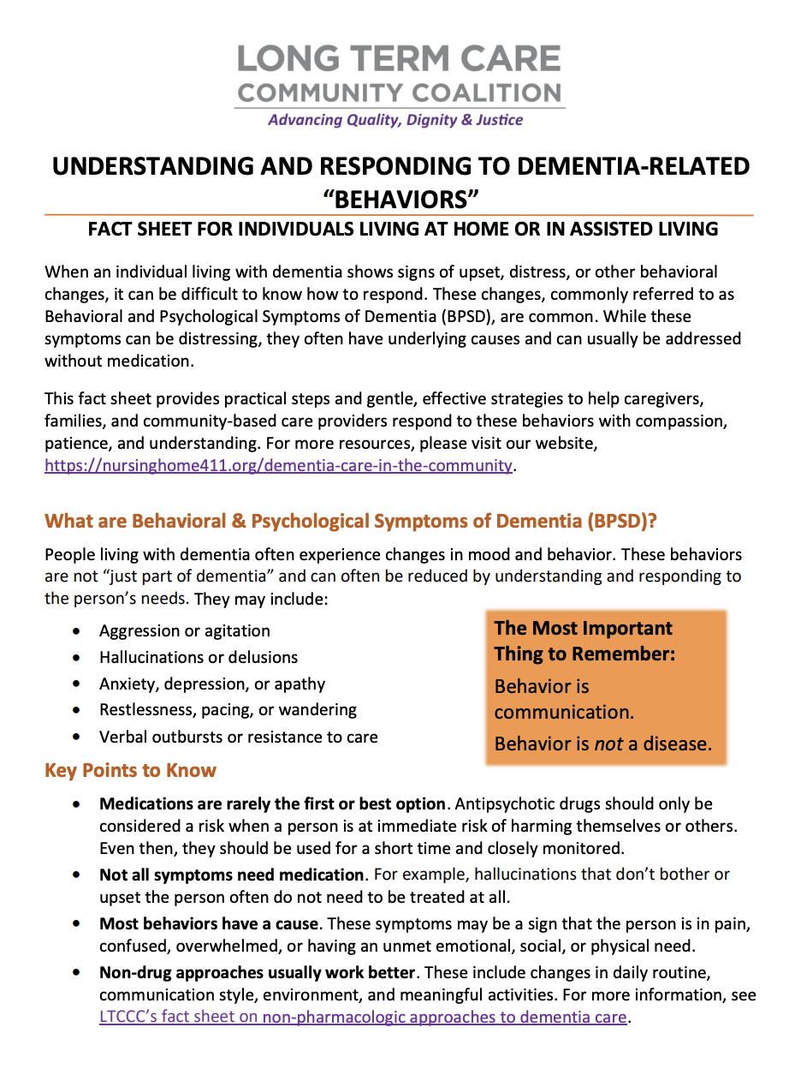
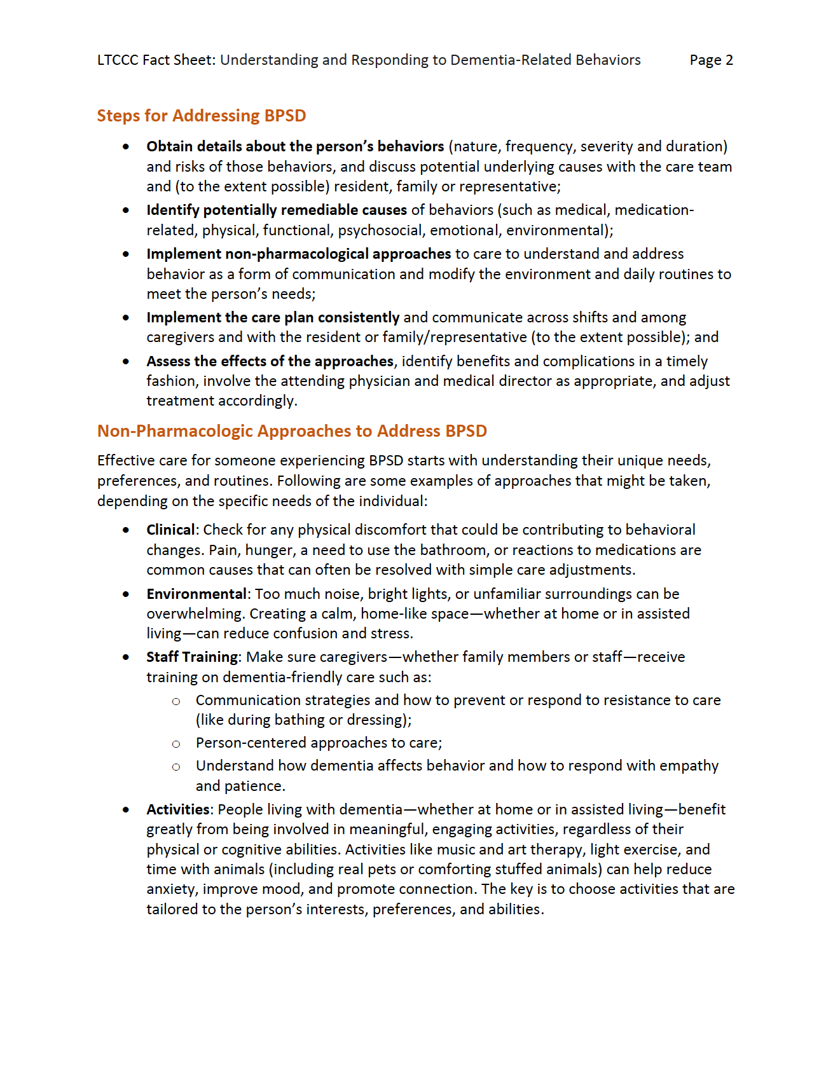

Slide 11
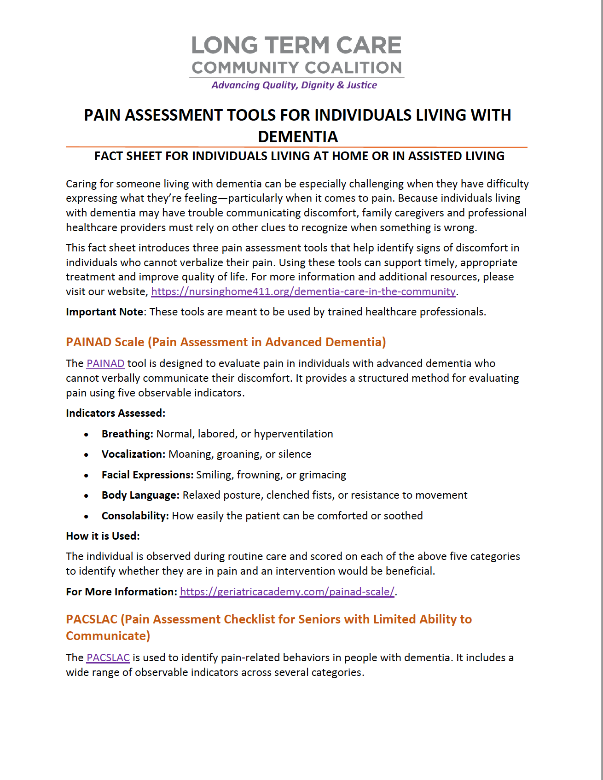
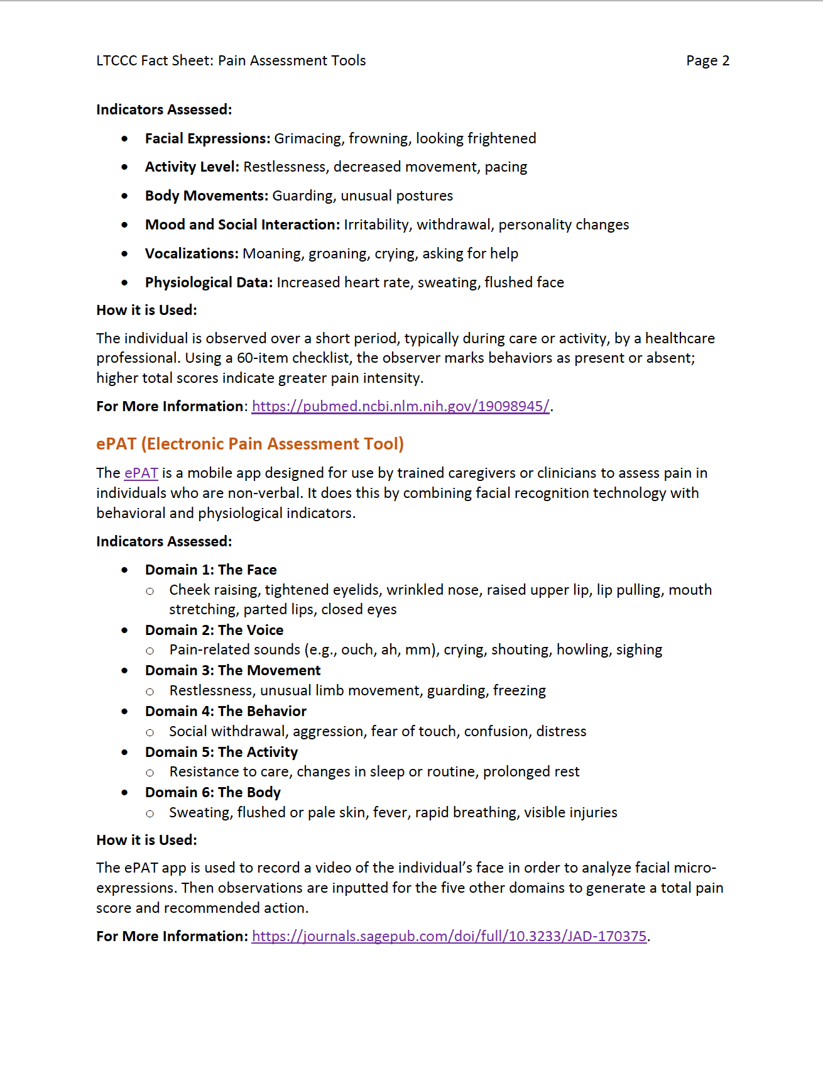

Slide 12
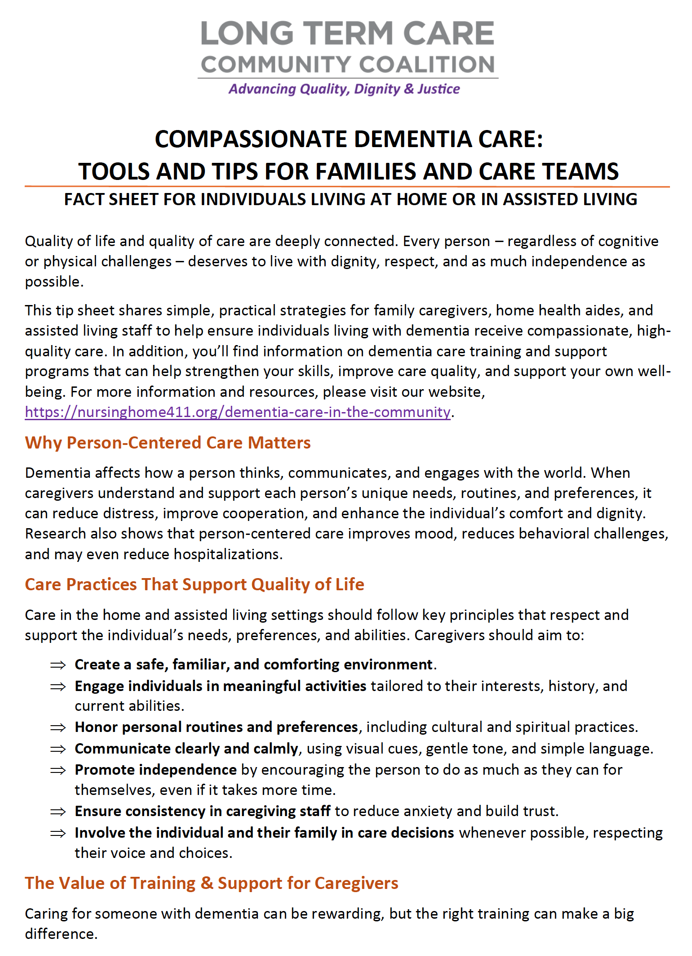
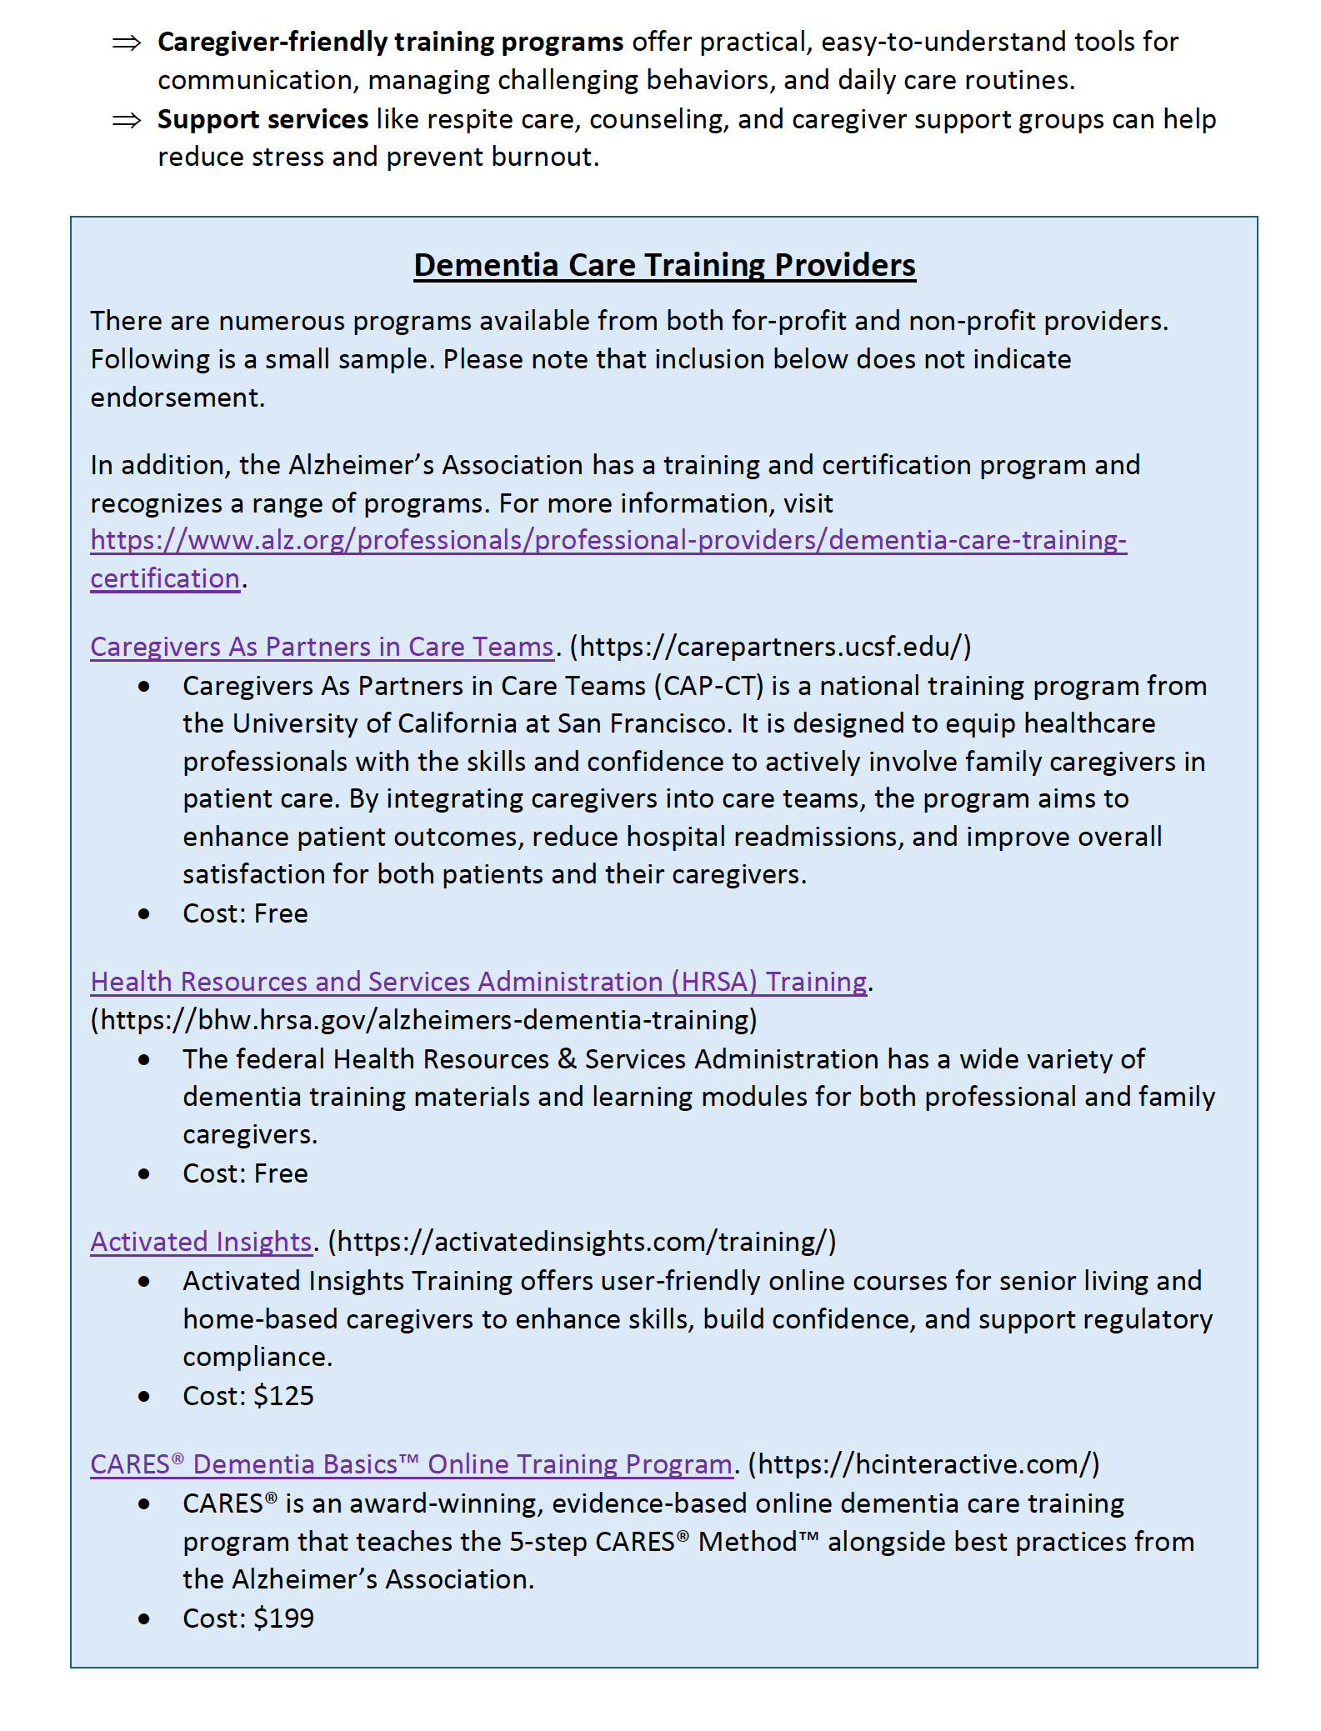

Slide 13
How You Might Use Fact Sheets
Share during a pastoral visit or caregiving conversation
Use as handouts in a support group or workshop
Email or print for caregivers needing guidance
Use one sheet as the focus of a 15-30 minute session

Slide 14
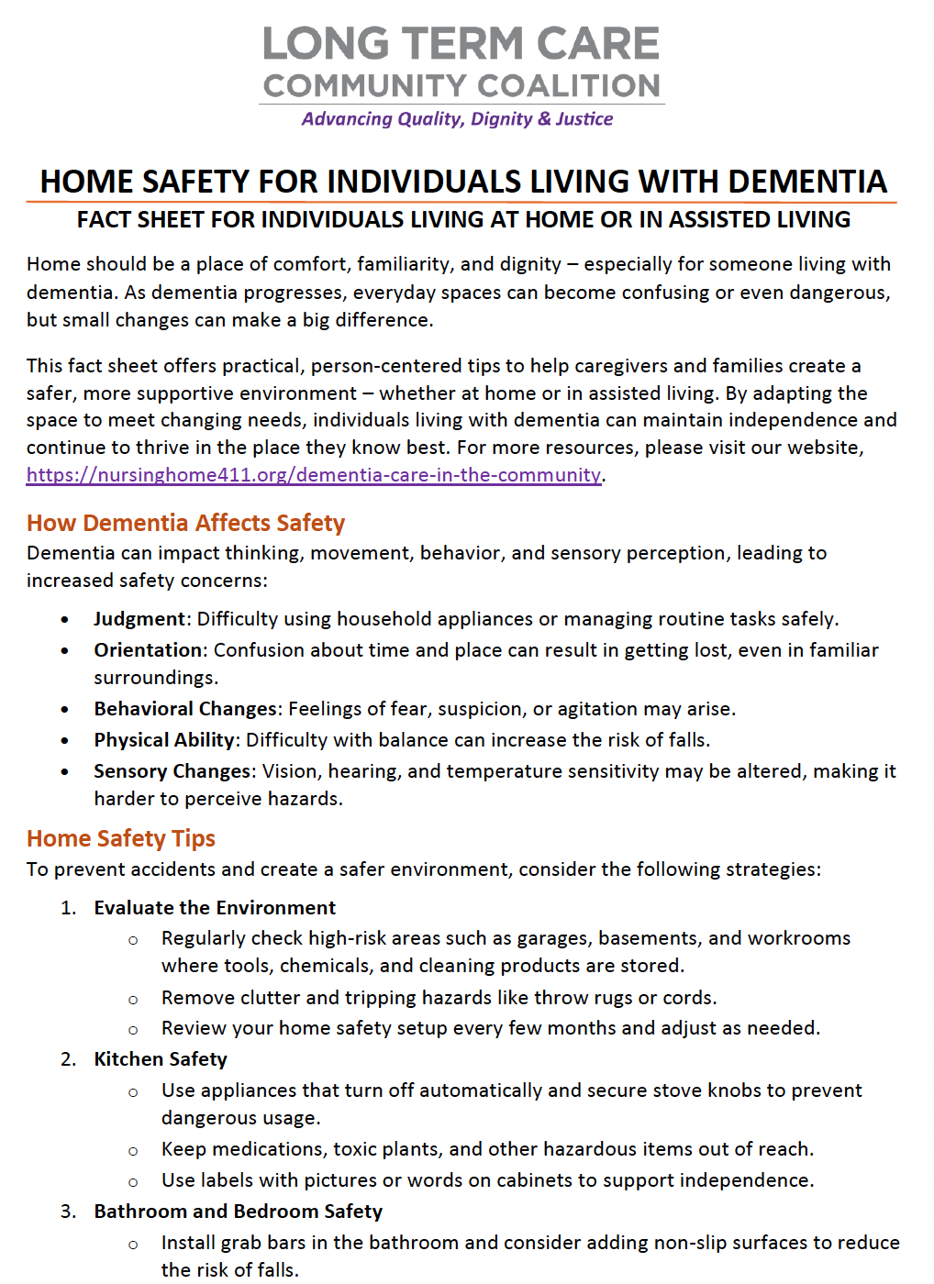
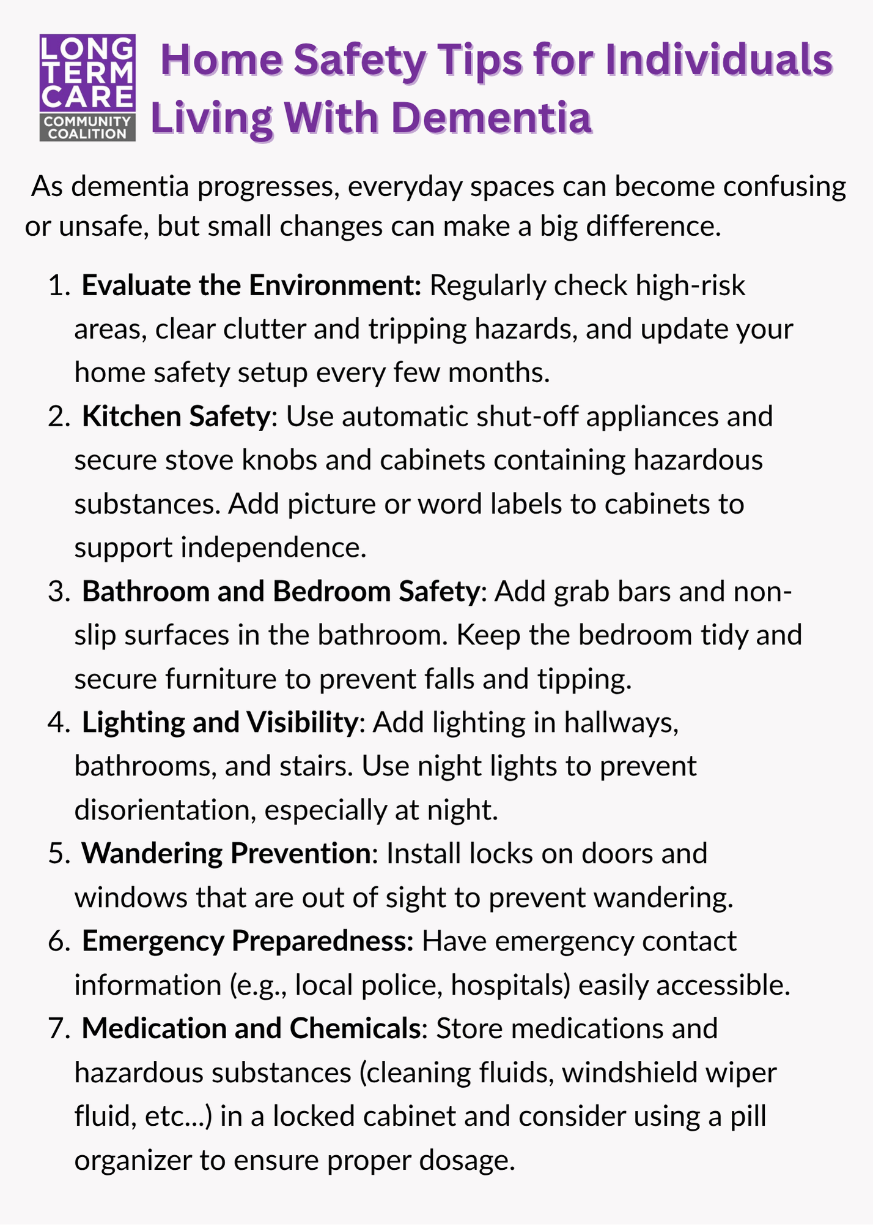
Care Cards: What They Provide
Short, focused tips for specific caregiving challenges
Designed for moments of stress, confusion, or uncertainty
Easy to print or keep on a phone
Provide immediate, actionable guidance

Slide 15
How You Might Use Care Cards
Share directly with a caregiver in a moment of need
Review together during a conversation
Highlight one card per week in your communications
Use as a quick follow-up after a discussion

Slide 16
Mini-Modules: What They Provide
Short educational videos on key dementia care topics
Designed for flexibility – watch alone or in groups
Reinforce and expand on fact sheet topics
Help build confidence among volunteers and leaders

Slide 17
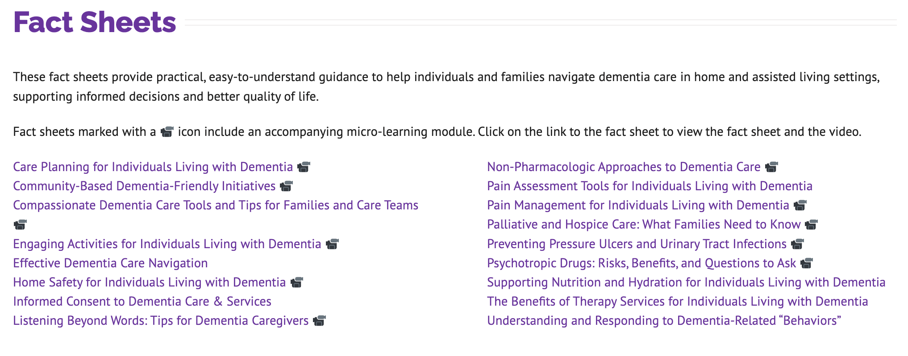

Slide 18
How You Might Use Mini-Modules
Show during a small group or caregiver session
Pause to discuss key points
Assign as optional learning for volunteers
Combine with fact sheets for deeper understanding

Slide 19
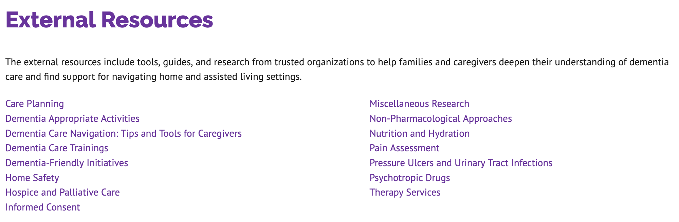
External Resource Library
All of the fact sheets and care cards are based on professional standards and expert research. The Toolkit page provides a curated list of these external resources for those looking to dig deeper.

Slide 20
Leading a Simple 30-Minute Session
5 min: welcome and check-in
10 min: review a fact sheet or mini-module
10 min: group discussion and sharing
5 min: share care cards and next steps

Slide 21
What This Looks Like in Practice
Start with empathy and acknowledgment of caregiving challenges
Use one resource – not too many at once
Encourage sharing without pressure
End with something practical they can take with them

Slide 22
Supporting Caregivers One-on-One
Use toolkit during pastoral care or support conversations
Offer a specific resource instead of general advice
Follow up with additional materials
Help caregivers feel informed and less alone

Slide 23
Simple Ways to Share the Toolkit
Add link to bulletins, newsletters, or website
Mention during announcements or sermons
Send directly to individuals who may benefit
Introduce gradually – one resource at a time

Slide 24
Community Announcement Sample
Dementia Care Resources for Our Community
Across our community, many individuals are quietly caring for loved ones living with dementia. Caregiving can be both meaningful and challenging – and having the right information and support can make a difference.
The Long Term Care Community Coalition (LTCCC) offers a free Dementia Care in the Community Toolkit designed for caregivers, families, and community members. This resource includes:
Plain-language fact sheets on dementia care, communication, and safety
Quick “Care Cards” with tips for everyday caregiving situations
Short educational materials and links to additional trusted resources
These tools are practical, easy to use, and available in English and Spanish.
Explore the toolkit: https://nursinghome411.org/dementia-care-in-the-community.

Slide 25
Building a Sustainable Approach
Start with one conversation or small group
Train a few leaders or volunteers
Integrate into existing ministries
Build awareness over time

Slide 26
Reflection
Who in your community could benefit from this?
What is one resource you could share this week?
What is one small step you can take?
What feels realistic to start with?

Slide 27
Next Steps
Explore the toolkit yourself
  Nursinghome411.org/dementia-care-in-the-community
Share at least one resource this week
Plan a conversation or session
Reach out to LTCCC for support
  info@ltccc.org
Additional resources available through LTCCC

Slide 28
Thank you!
Questions?
Comments?
nursinghome411.org

